Slide 1
Beyond the BARRIERS: ensuring Equitable Access to Education for Youth in Dependency Before, During, & After Residential Placements
Ashli Giles-Perkins, M.ED., ESQ.
STAFF ATTORNEY
October 29, 2025
Lehigh County Bar Association CLE
(1.5hrs)
Notes:
I am looking forward to providing an in-depth training (1.5hrs.) covering the state and federal rights of system-involved students, school discipline + disparities, educational rights of students in residential placements and how to best support and navigate educational rights for dependent youth

Slide 2
Key Topics & overview (1.5Hrs)
Relevant background on Youth in Care
Review of profiles of (residential) youth who are system-involved
Review of education-related barriers faced in residential settings
State & Federal Laws on Educational Rights Youth in Dependency
Changes in Placement
Least Restrictive Environment
Best Interest Determination
Educational Quality in Residential Settings
Obligations of School Districts
Immediate Enrollment
Understanding and Enforcing Act 1
The Role of the Court in Education
Highlights of Dependency Bench Book
Key Language in Court Orders
Questions and Closing

Slide 3
LEARNING OBJECTIVES
Participants will gain knowledge about:
I. State and federal statutory rights of children who enter, reside in, and transition from residential settings
III. Juvenile Court Rules applicable to students in foster care and guidance highlighted in the Dependency Bench Book.
II. Act I of 2022, which provides additional supports to enable highly mobile students to make progress in school, including timely access to a high school diploma.
IV. Findings and recommendations from NEW Report on Students in Foster Care.
Participants will learn new strategies to effectively advance the educational rights of students including:
Strategies to address the unmet educational needs of children with disabilities and the obligations of public schools where students reside in residential placements.
Tools to ensure effective decision-making regarding school stability and immediate enrollment, including tips on how to navigate beyond delays, lack of records, BIDs and institutionalized bias.
Legal options and strategies to hold school districts accountable.

Slide 4

About your presenter
From Connecticut and attended University of New Haven
Criminal Justice & Psychology
Graduate of Loyola University Chicago School of Law and The Loyola-Chicago Graduate School of Education with a Master’s of Education in cultural educational policy studies.
Community Organizing background which centered: zip-code equity in school funding, youth civic engagement, mitigating the school-to-prison pipeline, development of culturally-responsive curriculum and utilized tools such as coalition building, grassroots-centered lobbying, and campaign work.
At ELC I work closely on the following:
Black Girls Education Justice Initiative
Exclusionary School Discipline
Honest Education + Inclusive Schools
Youth in Residential Settings, including work on systemic/impact claims like the ACJ, PJJSC, and students in hospitals.

Slide 5
Foster care overview

Slide 6
The foster care system
In general, foster care is meant to be a temporary intervention to ensure child safety.
Nationally there are roughly 400,000 children in foster care each year, 270,00 are school age and many are eligible for early education.
PA estimates to have about 12,000 children in foster care. (Kids Count Data Center, 2023)
During the 2022-23 school year, over 8,800 students in foster care were enrolled in the Pennsylvania public schools (Pre-K-12).
In 2023, PA had its highest percentage of children living in kinship care: 38%
Reunification with biological family members in PA happens about 51% of the time. About 22% of all children in care will be adopted. Many others age out of care.
Notes:
Note that while numbers are trending down, PA still has a higher # of youth in group residential settings than other states

Slide 7
Older Youth & Aging Out Of Care
The foster care system
In 2021, over 19,000 youth transitioned out of foster care without parental reunification or another familial-like home. Fortunately, this number has been decreasingly steadily, but the reality is thousands of youth left on their own without stable homes, consistent services, or access to supports.
This contributes to expe­ri­encing behav­ioral, men­tal and phys­i­cal health issues, hous­ing prob­lems and home­less­ness, employ­ment and aca­d­e­m­ic dif­fi­cul­ties, ear­ly par­ent­hood, incar­cer­a­tion and oth­er poten­tial­ly life­long adver­si­ties. Disproportionately, this impacts youth of col­or and LGBTQ+ youth.
Source: Anne Casey Foundation, May 2023
Notes:
Down from 20,000+
https://www.childwelfare.gov/pubPDFs/educationalsupports.pdf - Resources

Slide 8
Racial disproportionality in the child welfare system
Nationally -
Black Children are 4.5x more likely to be placed in foster care than white children.
Black children are more than 5x more likely to re-enter foster care than white children.
Children of two or more races are 4.5x more likely to re-enter the foster care system than white children.
At the national level, children of color were overrepresented in reports of suspected maltreatment by all groups of reporters (as categorized in the National Child Abuse and Neglect Data System [NCANDS]) (Krase, 2013).
Additionally, due to the disproportional rates of poverty, staff of government agencies may have more contact with minority families seeking services or government benefits.
In short, higher visibility of these families was opined to result in their being referred to the child welfare system at a higher rate.
Source: Child Welfare Information Gateway. (2016). Racial disproportionality and disparity in child welfare. Washington, DC: U.S. Department of Health and Human Services, Children’s Bureau

Slide 9
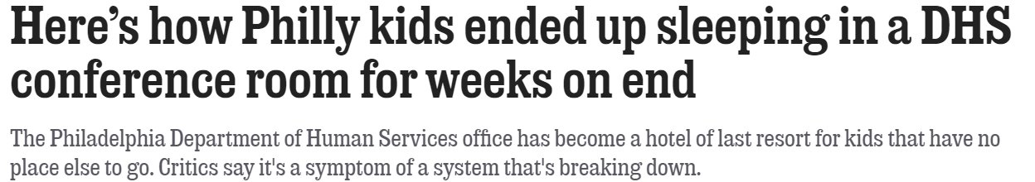
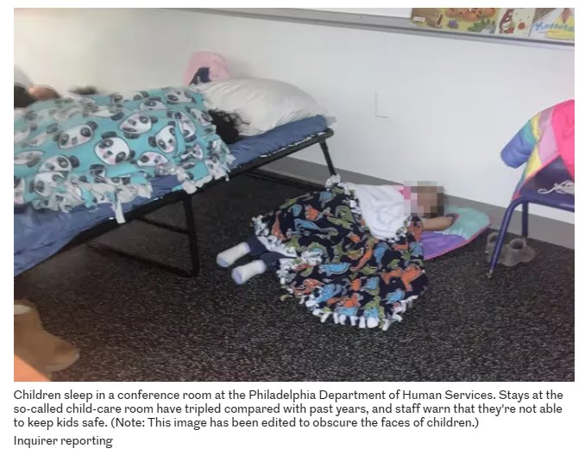
Notes:
10

Slide 10
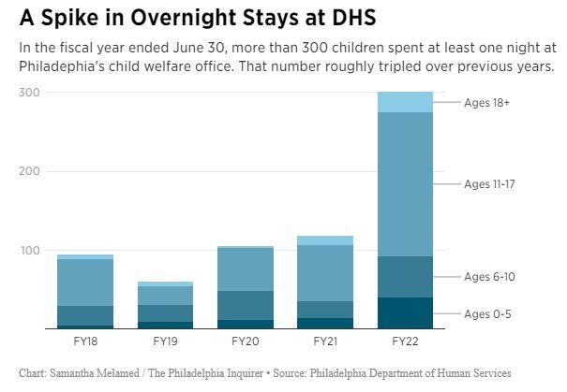
Notes:
10

Slide 11
Key Findings of Youth Transitioning out of Care
Exiting the foster care system
One in five report expe­ri­enc­ing home­less­ness between ages 17 and 19, and over one in four (29%) report being home­less from 19 to 21. Among Amer­i­can Indi­an and Alas­ka Native young adults, the fig­ure jumps to almost half (43%) for ages 19 to 21.
One in five of youth exiting care reported being incar­cer­at­ed between ages 17 to 19 as well as ages 19 to 21.
More data by state and race and eth­nic­i­ty.
One in 10 report becom­ing a par­ent between ages 17 to 19 while near­ly one in four (23%) say they became par­ents between ages 19 to 21.
By age 21, over two-thirds (70%) have a high school diplo­ma or equiv­a­lent. The same is true for 64% of Amer­i­can Indi­an and Alas­ka Native and 78% of Asian Amer­i­can young adults.
Just 57% report being employed (full- or part-time) at age 21, with this fig­ure rang­ing from 51% for Amer­i­can Indi­an and Alas­ka Native young adults to 63% for Asian Americans.

Slide 12
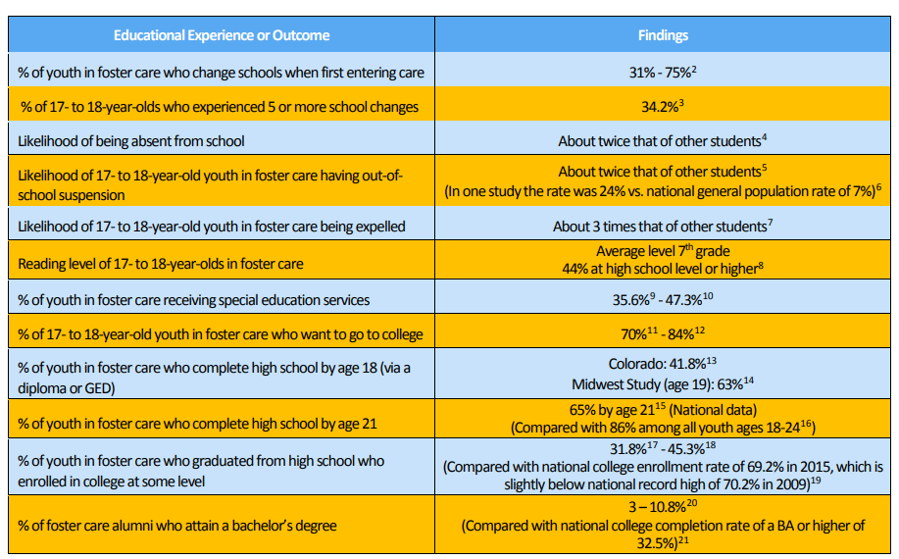
National Education Data and Regional Data Based on Special Studies
National Factsheet: Fostering Success in Education, 2018

Slide 13
Understanding school types & RESIDENTIAL FACILITIES

Slide 14
Types of Schools in PA
There are many different types of schools that serve youth who are dependent:
Typical public schools: K-12 schools with the full curriculum, including a continuum of special education programs (e.g. – Allentown High School). Also includes charter schools, which are public schools.
Full-time special education public schools: publicly-run schools that have specialized programs JUST for students with disabilities; typically districts place students. (e.g. – DCIU’s The County Alternative/TCA or Lincoln IU #12, York Learning Center)
Approved private schools: privately-run schools that have specialized programs JUST for students with disabilities (e.g. – Green Tree School, the PA School for the Deaf)
Private academic schools: privately-run schools that may have a specific focus but serve a variety of students and have few regulations. (e.g. – Lehigh Learning Academy; New Oaks Academy at Belmont BHH)
Detention Center Programs: publicly-run schools in detention centers, typically run by intermediate units (e.g. - Philadelphia Juvenile Justice Services Center; Northampton County JJC operated by Colonial Intermediate Unit #20)
Residential Treatment Facilities: May have an on-grounds program and/or partner with the local school district to offer aligned education for youth with complex needs. Student lives there. (e.g. The Melmark School)

Slide 15
Licensing and Oversight of on-grounds schools in Pennsylvania
Licensed and regulated by the Pennsylvania School Board as “private academic schools.”
These programs are subject to on-site monitoring once every six years, and only with regard to students with disabilities.
Licensed by the State Board of Private Academic Schools.
Have wide discretion in creating education programs.
Not required to follow the same rigorous state curriculum requirements and academic standards as public schools.
Notes:
Existing in the shadows .. Undermined ability to graduate HS -- encourage surveys as this data is not kept
"Private academic school" or "school." A school maintained, or classes conducted, for the purpose of offering instruction for a consideration, profit or tuition to five or more pupils at one and the same time, or to 25 or more pupils during any school year, the purpose of which is to educate an individual generally or specially or to prepare an individual for more advanced study, and shall include all schools engaged in such education, except private trade schools, private business schools, private correspondence schools, private music schools, private dance schools, private art schools, private dramatic art schools, private schools of charm or poise, private driver training schools or any type of private school which is nonacademic in character.

Slide 16
Concerns with On-grounds schools
Multi-grade classrooms
Uncertified or improperly certified teachers
Below-grade-level course work
Limited instruction hours
Relies heavily on worksheets or online credit programs
Minimal live instruction or no teaching staff
Fail to advance basic skills
Notes:
Glen Mills example – switched to entirely virtual learning; staff members from the unit were not teachers;

Slide 17

A CASE STUDY: SYSTEMIC DEPRIVATIONS FOR YOUTH IN CONGREGATE CARE
The X School

Slide 18
SYSTEMIC DEPRIVATIONS FOR YOUTH IN CONGREGATE CARE
Instead of an APS, Lynx spent approx. 3 months at The X School, until November 2020 when he was abruptly told to leave because the school stated that it was not licensed to educate students with ID.
After spending a number of weeks without any school at all, Lynx was finally enrolled (virtually) into a supplemental life skills program at the neighborhood school in January 2021. Lynx remained without proper placement and related services.
On May 3rd, Lynx was finally accepted and enrolled into a full-time APS placement. ELC advocated to ensure he received compensatory education for the entire period of deprivation. ELC also raised systemic issues about the program’s policy with SDP.
Background
Lynx is a 14-year-old Black male student with an IEP for intellectual disability, emotional disturbance, who requires intensive speech-and-language supports.
For background, Lynx has been diagnosed with bipolar disorder, DMDD, and schizoaffective disorder & his IEP requires placement in a full-time emotional support program at an Approved Private School.
In April 2020, he was placed at X Placement by dependency court and began attending the on-grounds school... A decision his EDM strongly opposed and questioned.
Notes:
Ashli
Unforunately Lynx is just one of at least 4 students who was the X School, THAT WE KNOW OF, who was abruptly unenrolled. ELC is investigating further and pushing the School District to implement better oversight and prevent this from happening to other SWD

Slide 19
SYSTEMIC DEPRIVATIONS FOR YOUTH IN CONGREGATE CARE
Background
Asher is a 15-year-old Black male student in foster care who receives supplemental learning supports through his IEP.
Asher was also placed at X Placement by dependency court, and automatically began attending the on-grounds school. He was enrolled for over a year-and-a-half.
In those 18 months, the X School never convened an IEP review, or sought any updated testing or evaluations.
Worse, upon gathering records, it was not clear what grade Asher was in. His records had not be updated since his arrival. A court order was provided to the placement in order to obtain records after months of requests.
Once records were received from the X school, we learned Asher had over 50 absences and was failing all subjects. When staff were asked about the numerous absences for an on-site school program, they shared they do not force students to attend school.
It was further determined that like Lynx, Asher was automatically enrolled at the X School, simply because he resided at the X placement, despite it not being the LRE, and despite a right to attend the local public school.
Asher’s mom (still his educ rights holder) informed ELC she did not know there was an option to attend the local school, this option was never presented by staff, and asked to pursue this option.
ELC successfully advocated to ensure Asher was in an appropriate placement in the local public school district, including a bus to and from the placement, and further ensured Asher received compensatory education for the entire period of deprivation.
Notes:
Unforunately, Lynx is just one of at least 4 students who was the X School, and who was abruptly unenrolled. ELC is investigating further and pushing the School District to implement better oversight and prevent this from happening to other SWD

Slide 20
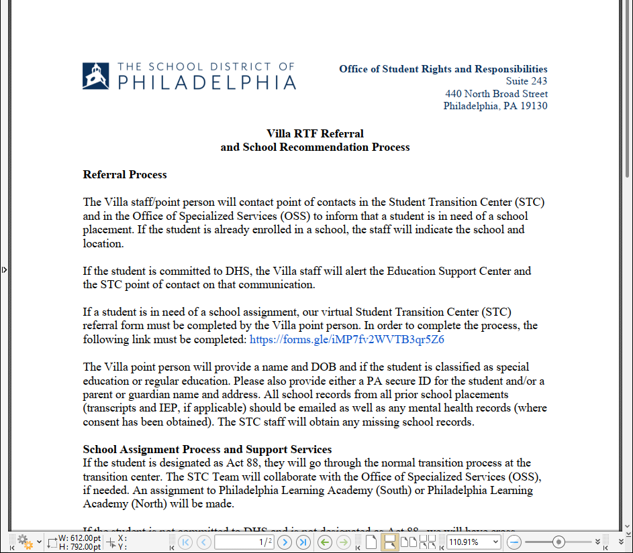
Systemic reforms for students at the bridge
Notes:
Advocacy pays off – flag that there is a need for wider statewide reforms

Slide 21
EDUCATIONAL PROFILE OF SYSTEM-INVOLVED (dependency) YOUTH

Slide 22
Who is placed at Residential Facilities in Pa?
44.7%
of children in foster care in Pennsylvania are African American
----------
50.5%
of children placed in residential settings are African American

Slide 23
Highly Mobile Students
Youth who are homeless uprooted sixteen times more frequently than their peers
Children in foster care change schools an average of 2.8 times; Most older youth have been in 5 or more schools
Research indicates that children lose 4-6 months of progress with each school move
Even one fewer school change makes a high school student 1.8 times more likely to obtain a diploma
Maintaining School Stability Pays Off:
A child who stays in the same school is 50% more likely to graduate and exhibit higher academic achievement:
GPA: Increases by 50%
Reading and Math levels are higher
Less likely to repeat a grade
See National Fact Sheet on Foster Care and Education (collecting national and regional studies)
Notes:
See National Fact Sheet on Foster Care and Education (collecting national and regional studies)

Slide 24
System-Involved Youth: Educational Profile
See e.g., National Fact Sheet on Foster Care and Education and Council of State Governments Justice Center, Locked Out: Improving Educational and Vocational Outcomes for Incarcerated Youth, 4 (2015).
Compared to other students, youth who are “system involved” experience:
Higher rates of school mobility
Frequent school changes often lead to lost records, credits not transferring
Higher rates of school suspension
Lower standardized test scores in reading and math
Higher rates of grade retention
Higher rates of developmental delays and behavioral health needs
Incomplete evaluations/out-of-date IEP and therefore not enough information to develop quality IEP
Residential placements often disrupt learning and fail to follow IEP​
Failure to identify children, inappropriate disability identification, lack of continuity for progress monitoring, record transfer issues, poor transition plans, need for more specific and consistent behavioral plans
More likely to need special education services, but less likely to receive appropriate special education services
Notes:
All of these issue compound on top of one another
See e.g., National Fact Sheet on Foster Care and Education and
Council of State Governments Justice Center, Locked Out: Improving Educational and Vocational Outcomes for Incarcerated Youth, 4 (2015), https://csgjusticecenter.org/wp-content/uploads/2015/11/LOCKED_OUT_Improving_Educational_and_Vocational_Outcomes_for_Incarcerated_Youth.pdf.

Slide 25
Concerns with On-grounds schools and students with disabilities
Delays in obtaining the child’s IEP
Failure to follow a child’s IEP or provide related services
Failing to conduct timely evaluations to determine educational needs
Failure of school staff to modify instruction
Lack of rigorous progress monitoring
Denied the opportunity to be educated in the least restrictive environment

Slide 26
State & Federal Laws on Educational Rights of System-Involved Youth

Slide 27
Children in Foster Care
Children in Juvenile Justice
Rights for students in foster care
Key Law: Every Student Succeeds Act (“ESSA”)
Right to immediate enrollment: enroll regardless of paperwork and obtain afterwards
School stability: students remain in the “school of origin” if it is in the best interest of the child
Best Interest Determinations (“BID”) held virtually or in-person
Fostering Connections Act: Child welfare agents can obtain education records without consent and re-disclose to other education entities to address the individual needs of students
Rights for students in JJ
Key Law: Every Student Succeeds Act (“ESSA”)
Timely and appropriate enrollment in a program that best meets needs
High schools must assist youth in obtaining a regular high school diploma
24 P.S. 13-1306: Unless a court order specifies otherwise, there is a right to public school enrollment
Act 1 for students experiencing educational instability. 23 P.S. 13-1331.1
Notes:
ELC - Ashli

Slide 28
Who is the LEA?
Local Education Agency
An LEA point of contact is a critical link for schools; the entity charged with ensuring compliance with necessary laws
Who is the LEA?
For most students, the LEA is the school district where the student and parent resides including
Students in approved private schools
Students in AEDY programs
For students with school stability, LEA is the school district determined by BID
For preschool children, the LEA is Elwyn (Philadelphia) or the Intermediate Unit
For students placed residentially, the LEA is the school district where the residential placement is located (host school district)
Charter Schools are often their own LEA.

Slide 29
Key Federal Laws Protecting Students
Individuals with Disabilities Education Act (IDEA,1975)
The IDEA is a federal law that provides students with disabilities the right to receive a free and appropriate public education (FAPE) designed to meet their unique needs.
The U.S. Constitution (Note this is NOT a federal right to education)
14th Amendment, Due process & Equal protection claims
William Penn School District et al. v. Pa. Dept. of Education et al., 294 A.3d 537, 962 (Pa. Commonw. Ct. 2023)
Family Educational Rights and Privacy Act (FERPA)
Federal law that protects the privacy of student education records; governs the request of records
Students in Foster Care:
Every Student Succeeds Act (2015) (established obligations of child welfare & local education agencies to provide school stability and immediate enrollment for all students in foster care)
Fostering Connections Act (2008)
Uninterrupted Scholars Act (2013): Child welfare exception permits child welfare representatives to obtain education records of children in foster care without consent and to re-disclose to others to address the individual needs of students. 20 U.S.C. § 1232g(b)(1)(L).
Students Experiencing Homelessness:
McKinney Vento Act, 42 U.S.C. 11431 et. seq. ESSA (2016) (school stability and immediate enrollment for students who are experiencing homelessness)

Slide 30
Every Student Succeeds Act (ESSA)
State Education Agency (SEA) must ensure school stability for ALL children in foster care.
Locate and contact a district’s Foster Care Liaison as a first point person; Raise complaints to the Regional Coordinator and/or State School Stability & Foster Care Coordinator (https://www.pafostercare.org/)
PDE is responsible for ensuring that LEAs provide school stability or immediate enrollment
LEAs must develop and implement plans for the transportation of foster youth to their school of origin, when in their best interest.
PDE, BEC on ESSA
Consolidated PA Plan, Jan 2023
Notes:
BID and IEP meetings ideally should be separate, with the EDM participating in both, but the final decisions being made by EDM and IEP team only for IEP when meetings are merged

Slide 31
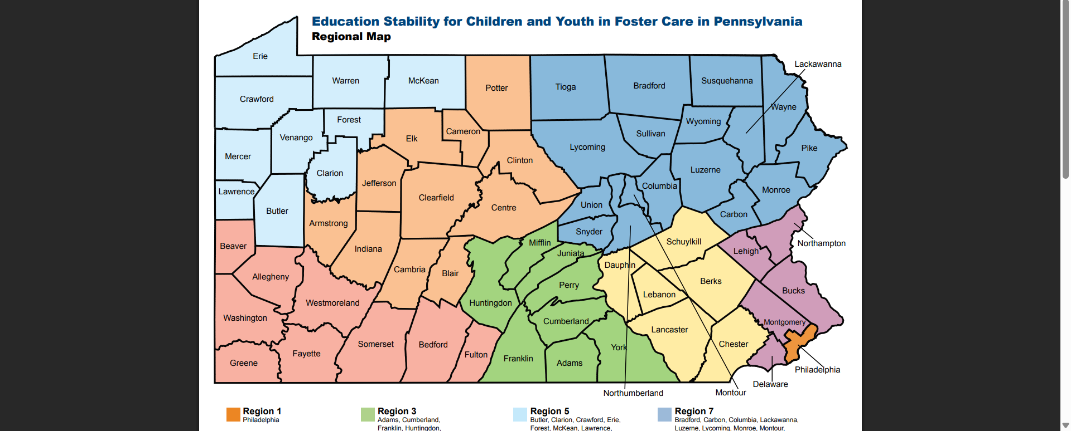
Locate the region and involve the regional coordinator
Lehigh County is in Region #8.

Slide 32
Fostering Connections to success and increasing adoptions Act of 2008
Designed to assist hundreds of thousands of children and youth in foster care by promoting permanent families for them through relative guardianship and adoption, improving health care, and supporting educational stability.
Requires caseworkers to consider proximity and appropriateness of prior school when placing a child in out-of-home placement.
Requires caseworkers to ensure school stability when in the child’s best interest.
Requires caseworkers to ensure immediate enrollment in a new school with records to follow.
Allows child welfare to draw down administrative/maintenance dollars to support transportation – but only applies IF child is Title IV-E eligible.
No reciprocal mandate on education agencies.
National Center for Homeless Education Resource

Slide 33
Educational rights of children in residential placements
All children in residential facilities have a clear legal entitlement to attend the local public school where the residential placement is located unless there is a court order specifying a school placement. 24 P.S. § 13-1306
Decision regarding where a child attends school must be made on an individual basis.
Cannot be made by the referring public agency.
Cannot be made in the private provider’s interest in having the child attend the provider’s on-site educational program.
Bundling is expressly prohibited.
Notes:
Often referred to as 1306

Slide 34
Best Interest Determination (“BID”) meetings
Must be held whenever there is a new or change in out-of-home placement. Can be held in person, virtually, or even via agreement by email.
Should occur within 3 days of the placement change.
Can and should be requested earlier when the change (address) is known
The purpose is to determine whether the student will maintain school stability, or if the factors indicate that decision would not be in their best interests, determine where the student will go to school. The presumption is that the student “shall remain in their school of origin, unless” standard.
The BID is not the same as the IEP meeting – consider different factors, requires different parties to attend. A student with a disability in care has a right to pendency (prior placement) and school stability. Students with specialized school placements on their IEP should maintain that school placement, regardless of a change to their home placement,
BID must include:
Legal representative of the child (i.e. – EDM, biological parent who retains educational rights, foster parents)
LEA point of contact for BOTH school districts
Notes:
Marcos hypo with delays

Slide 35
Best Interest Determination cont’d
Who to Include in the BID:
Whenever appropriate-the student themselves, representatives from the student’s prior school AND the school district the student is moving into, EDM, bio parent, foster parent, CUA/caseworker, GAL, and others who know the student
Tip: Aim to include/invite folks who will support the student’s voice (coach, teacher, mentor)
The BID will review the appropriateness of the current school, student’s particular needs, and travel distance from the school will be considered
Presumption is always in favor of remaining in the school of origin
Costs are NOT a factor for consideration
The DHS-OCY is charged with convening the BID upon request, facilitating the meeting, and contributing to the team decision making, but anyone can request a BID.
Contact the Lehigh County Office of Children and Youth Services (CYS) to request a BID meeting
Phone: 610-782-3064
A formal request should be submitted in writing (email included). Seek interventions whenever there are delays.

Slide 36
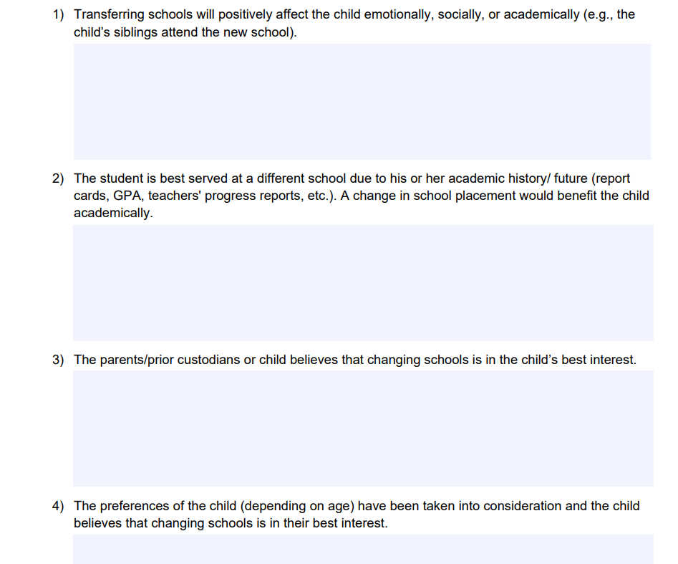
Bid factors and supporting documents
Supporting Documentation
considerations
The following list of sample documents is not exhaustive;
• Report cards
• Progress reports
• Achievement data
• Attendance records
• Individualized education plan (IEP)
• Section 504 plan
• Family service plan
• Child permanency plan
• Individualized service plan
• Emails or correspondence from individuals consulted
• Documentation supporting child’s participation in extracurricular activities such as athletics, clubs, or afterschool programs

Slide 37
Problems with the bid process or conference
Parent, Guardian, or EDM not invited to participate or key parties not notified of the change in placement
Delay in convening a BID conference timely (within 3 days of the change)
Student is disenrolled before the BID occurs
District claims to not “contract with” certain programs, providers, or transportation companies
BIDs via e-mail only
Raising a grievance or seeking accountability with no/limited response
Too much emphasis on travel (costs) and convenience for receiving school district
A failure of the team to consider ALL relevant BID factors
Uncertainty in who gets a “vote” and the weight it has

Slide 38
special education considerations

Slide 39
Special Education
Special Education cont.
Students have robust rights
Individuals with Disabilities Education Act (“IDEA”)
Section 504 of the Rehabilitation Act
Americans with Disabilities Act (“ADA”)
Evaluations
All children suspected of having a disability must be evaluated
Child Find Obligations
Evaluation must be completed within 60 days of signed consent from the IDEA parent
Eligibility Asks: 1) does a student have a disability; AND, 2) does the disability require special education supports?
Students with IEPs should be re-evaluated at least every 2-3 years
Parent (or School) can request this to occur sooner
Under state law (22 PA. CODE § 14.123(c)) schools are required to respond in writing within 10 days to requests to evaluate, including oral requests.
The parent may challenge the LEA’s refusal by requesting a due process hearing under 34 C.F.R. § 300.507 or filing a State complaint under 34 C.F.R. § 300.153.
An Individualized Education Program (“IEP”) are legally binding documents and must be revised at least annually and provide students with a FAPE
Free Appropriate Public Education: provide services to ensure that a student gets meaningful benefit from school
Address all areas of need
Strong Disciplinary Protections
If the discipline will result in a change in placement, IEP Team must determine if the behavior in question manifested because of a student’s disability*
Students cannot be excluded for behaviors related to their disabilities
Students with intellectual disabilities should never be suspended or expelled, with a few exceptions (IAES, AEDY)
Compensatory Education: services for students with IEPs who experienced educational deprivations that resulted in skills loss
Services to make up for losses or deprivations
Required if a student did not make progress, regressed, or did not receive required IEP services
Includes funding of staffing difficulties
Notes:
An IEP, or Individualized Education Program, is a legally binding document, governed by the IDEA, a federal law.
There is a right to request a child be evaluated for special education services. & should do this in writing, and the school is obligated to respond – by sending a consent form, or a letter declining to evaluate and why not.
For children with intellectual disabilities, exclusionary discipline is NOT permissible, unless:
There is a court order, parental consent, or agreement from Pennsylvania Dept. of Education

Slide 40
Timely Evaluations: Special Considerations
Evaluation Timeline: Highly mobile children in foster care or who are homeless should evaluated on “an expedited basis within 30 days”
Letter From Office of Special Education and Rehabilitative Services to State Directors of Special Education Re Highly Mobile Children With Disabilities (July 19, 2013)
Other Considerations:
Private evaluations or evaluations conducted by the child welfare agency or juvenile justice facility should be considered;
Assess children in ALL areas of suspected disability as diagnosis may be incorrect from a prior school;
This is also true when conducting the manifestation conference. More than what is currently being programmed for can be considered.
Foster parents/surrogate parents must be members of the evaluation team and treated in the same manner as the biological parent.
Notes:
EMPHASIS ON GUIDANCE (should follow, not required)
available at
https://www2.ed.gov/policy/speced/guid/idea/memosdcltrs/12-0392dclhighlymobile.pdf.

Slide 41
Manifestation Determinations
What is it? When is it triggered?
Then What?
1. Students who have IEPs, students with “qualifying disabilities” who are suspected to be eligible, or students who don’t have an IEP but need accommodations in school under a “504 Plan” cannot be disciplined on the basis of their disability.
2. Special rules apply if a school wants to suspend a student with an Individualized Education Program (IEP) for more than:
10+ days in a row (expulsion) or
10 total days in a school year for a “pattern of behavior”, or
15 total days in a school year.
(read: any changes in the student’s placement)
3. At the MDR meeting, IEP Teams must consider:​
Whether the behavior is called by the student's disability, or ​
Whether the school failed to follow a child's IEP
If it was a manifestation, the child cannot be expelled or suspended for more than 10 days in a row or 15 school days in the school year. In addition, the IEP team must also conduct a Functional Behavioral Assessment or revise a child’s Positive Behavior Support Plan.
Exceptions for weapons, drugs, and serious bodily injury apply; Students who are deemed a “threat”
The student can be removed for up to 45 school days to an alternative placement.
If the team decides it was not a manifestation but the parent disagrees with the team’s decision, the parent has the right to request a special education hearing. If a student with disabilities is suspended or expelled (for whatever length of time), the school district or charter school must still arrange for the student to receive a free, appropriate public education in accordance with the child’s IEP during the entire time the student is out of school.
If the team decides it was not a manifestation, and there is no disagreement on record, the discipline proceeds as proposed/implemented.

Slide 42
Exclusionary discipline in a virtual world
Exclusionary discipline triggers due process protections.
Students who are told not to return to school, or “participate virtually” for a few days are being excluded
For students with disabilities, this is a change in placement
For students who are excluded for days at a time, the removal may constitute a constructive suspension. After 10 days, it is a constructive expulsion.
Requiring early “pick ups” or dismissing a student are considered exclusionary discipline (informal suspensions).
For students with disabilities, it could be advantageous to document the absences as such in order to trigger a manifestation, IEP meeting, additional assessments, and more.
For students without disabilities, this kind of pattern could indicate a student needs an evaluation (including an FBA) and/or increased school supports,
Be mindful of students who attend on-grounds schools, and are kept from school as a disciplinary consequence, often for behaviors occurring in the placement. Often, this is still considered exclusion from the classroom and should be documented as a suspension, with due process owed.

Slide 43
Students returning from placement
Students returning from placement should not be automatically tracked into an alternative, cyber, or inferior school options.
For students who have been adjudicated of felonies, some Districts track them into alternative settings simply because they are returning from a placement. Note, some exceptions do exist for Act 110 students.
Students always have the right to attend their local neighborhood school (unless currently expelled from that school/district). This is strengthened further for youth in care who can exercise school stability.
Notes:
Why was Act 110 adopted? This state law, effective in January 2021, was enacted to protect student survivors/victims of sexual assault.1 The law requires that a student convicted or adjudicated delinquent of sexual assault against a student in the same school entity be transferred to another school, placed in alternative education for disruptive youth, or expelled from the same school entity under certain circumstances. Does Act 110 apply to students in all schools? No. The law does not apply to private or parochial schools. The law applies to all public school entities, including school districts, independent schools, area career and technical schools, intermediate units, charter schools, regional charter schools, and cyber charter schools. What does Act 110 require? Schools must ensure that the convicted or adjudicated student is not educated in the same school building, transported on the same school vehicle, or permitted to participate in the same school-sponsored activities at the same time as the victim.

Slide 44
Who Makes Special Education Decisions for System- Involved Students?
Children in foster care may have no active, involved parent. This is a particular problem for children in residential settings (group homes, residential programs, hospitals, etc.) who do not have a foster parent to serve in this role. Foster parents may change frequently, and schools may not have updated information to contact the proper individual.
Unaccompanied youth who are living on their own and experiencing homelessness often have no one to serve in this role.
Without a parent or other authorized adult to drive the special education process, nothing will move forward for the child. This contributes to poor educational and life outcomes for these students.
Judges and other key legal professional or advocates can play a crucial role in improving outcomes, just by asking the right questions at the right time.
Notes:
Who will make that request? Does that person have the ability to make decisions for this student? Who needs to be involved?

Slide 45
Educational decision makers & surrogate parents
Surrogate Parents are appointed by the school district.
The IDEA requires school districts to ensure that children who have been identified as needing special education or early intervention services, or who should be evaluated to determine eligibility, have an active engaged parent or other authorized adult to participate in the special education proceedings and to make special education decisions.
A school district must appoint a “surrogate parent” within 30 days of determining that there is no birth or adoptive parent or other person authorized by the IDEA to act on the child’s behalf in special education or early intervention matters.
Notes:
SURROGATE PARENT IS AN OBLIGATION AS PER FEDERAL LAW (AN ENTITLEMENT)
See https://www.elc-pa.org/wp-content/uploads/2014/04/ELC_Fact-Sheet_Ed_DecisionMakers_4_15_14.pdf

Slide 46

Educational decision makers & surrogate parents
“Educational Decision Maker” (EDM)
If there is no parent or guardian available or when the appointment of an EDM is in the child’s “best interest.” If an EDM is appointed, that person trumps all others—including a surrogate parent appointed by a school district
This appointment is made by a Juvenile Court judge.
If a judge appoints an EDM, that person is responsible for making all education decisions for the child, including special education and early intervention decisions.
Surrogate parents are responsible for IDEA or special education decision making only
Notes:
SURROGATE PARENT IS AN OBLIGATION AS PER FEDERAL LAW (AN ENTITLEMENT)
See https://www.elc-pa.org/wp-content/uploads/2014/04/ELC_Fact-Sheet_Ed_DecisionMakers_4_15_14.pdf

Slide 47
Increased support and monitoring of special education for youth in care
Ensure the child is in the least restrictive environment and is offered a continuum of placements, particularly if the child is returning from a residential living placement. 34 CFR § 300.114
The IEP should be substantially revised if child was in a more restrictive on-grounds school which may not have provided all needed services. 34 CFR § 300.324
Review and update the Functional Behavioral Assessment and Positive Behavior Support Plan prior to the child entering school. 34 CFR § 300.324
Progress monitoring reports should be provided on a more frequent basis for system-involved students with disabilities. 34 CFR §300.320(a)(2)(i)
Transition plans must be detailed & should be coordinated with child welfare “90-day discharge” and “Independent Living” transition plans. 34 CFR § 300.43
Notes:
Skim slide
**2 & 3

Slide 48
Seeking remedies for idea violations: consider a Due Process Hearings
Failure to identify students with disabilities/timely evaluations
Failure to conduct timely re-evaluation and need for IEE
Failure to program for student due to lack of records
Failure to appoint Surrogate Parent; no legally authorized decisionmaker
Failure to provide appropriate services in residential setting
Failure to ensure progress/lack of progress monitoring
Failure in conducting manifestation determination reviews (or failing to convene the MDR at all)
Poor transition plans for students who are system-involved
Graduating student without appropriate parent consent
Notes:
Expedited Due Process as another option – Raheem and Zaahir examples

Slide 49
Obligations of school districts to serve youth in care

Slide 50
PUBLIC SCHOOL Enrollment of Students In Residential
Children in foster care are entitled to immediate enrollment
Pennsylvania law on enrollment, 22 PA Code § 11.11(c)
Children in residential facilities are subject to the same rules
All resident children are entitled to attend the school district of residence within 5 days of presentation of documentation (proof of age, proof of immunizations, and proof of address)
Under Pennsylvania Law (state law) a student has the “right” to attend public school from age 6-21** years old, or until they graduate (whichever is first)
** Students with disabilities have the right to be educated until their 22nd birthday
Notes:
Some residential facilities do not have ongrounds schools; enrollment into local school is key
NOTE difference between the local school thru Dist., vs. Attending a local school that has a specialized program

Slide 51
Act 1 of 2022
Passed by the General Assembly in January 2022, Act 1 seeks to remove graduation barriers and support full integration into the school community for students who move between school districts due to homelessness, foster care, juvenile justice and other (court ordered) placements. Act 1 applies to students who graduated during the 2021-22 SY.
School Entity Responsibilities:
· Identify students who have experienced “education disruption”
· Establish a point of contact for each identified student
· Facilitate record transfer, credit assessment/waiver, and credit recovery
· Develop a student specific Graduation Plan
· Work with a prior school district (or PDE if necessary) to secure a diploma for a student who meets graduation requirements
Department Responsibilities:
· Develop a statewide secondary diploma “Keystone Diploma” as a last resort and work with school entities to issue the diploma to students who satisfy state graduation requirements
Act 1 (2022) 23 P.S. 13-1331.1
Notes:
Confirm good to skip?
school districts
charter schools
intermediate units
career and technical schools

Slide 52

Duties of schools
Assign
Assign individual “Points of Contact” to all eligible students to support youth to graduate and re-enter school.
Develop
Develop policies to ensure equal access to educational and non-educational activities
Define
Define how full and partial credits are assessed and counted towards graduation, how credits will be waived, and determine make-up options
Determine
If a student cannot graduate from their current school, determine if the student can graduate from their prior school
Assist
If a student can’t graduate from their current or prior school, assist the student to access to a state Keystone diploma (starting 2023) as a last resort.

Slide 53
Assessing Student Credits
Point of Contact must:
Verify previously earned credits documented in the student’s records, including partial credit
They should also determine whether there are courses or credits missing or accounted for incorrectly
Request a waiver of specific courses if student can demonstrate competency in content area or for other reasons
Ex. taking a test or completing a project, CTE course
If the course is not waived provide an alternative or modified course of study to assist student to finish by reasonably expected graduation date
Notes:
Should include passing a higher level course

Slide 54
Diploma options through act 1
If waivers and make up options are insufficient to allow a student to graduate on time in the current school:
POC should reach out to a prior school to determine if the prior school district would issue a diploma because the student meets the prior school’s graduation requirements
If no prior school district can graduate the student, they may apply for a statewide PDE “Keystone Diploma.” This is a valid high school diploma issued by the state.

Slide 55
Summarizing the School’s role
Enroll students in care immediately, without delay, and even without all enrollment documentation.
Coordinate with child welfare professionals to ensure school stability, provide proper staff to BID meetings,
Provide and/or coordinate to provide transportation for eligible students
Assess student for additional needs or support
Assign an Act 1 Point of Contact
Ensure the student is not subject to unnecessary or improper fines or fees that prohibit their participation in school
Determine if the student needs to be evaluated under Sec 504 or the IDEA
Over 34% of students in foster care are chronically absent, compared to 22% of students who are not in foster care.
Districts are required to convene meetings and create Student Attendance Improvement Plans (SAIP) for students deemed truant or struggling with attendance.
Convene IEP meetings, provide comparable services, and thoroughly review the student’s records.
Nationally, students in foster care are punished at far higher rates compared to students not in foster care.
Schools should revise policies or internal procedures to ensure students in care – who typically require more academic and/or emotional supports, including trauma informed response – are not pushed out of classrooms or schools altogether through exclusionary discipline or bias.
Ensure students in care are not disproportionately tracked into AEDY programs.
Students in foster care are placed in AEDY programs at a rate more than double that of students not in foster care

Slide 56
Aedy (also called “disciplinary transfer”)
Due Process Rights
Written notice with reasons for the hearing Informal hearing (meet with school, explain, present and question witnesses, records)
At Hearing, School Must Prove…
All other interventions and discipline have been tried and documented AND You still pose a clear threat to others’ safety, create an unsafe environment, materially interfere with learning, or disrupt education AND One of the following to a “marked degree”: Persistent rule violations Controlled substances at school Violence or threats at school Possession of a weapon at school Commission of a crime at school Misconduct meriting suspension or expulsion
Educational Rights
Must be a LICENSED alternative school (Camelot/Achieve Academy or Camelot East) Must provide at least 20 hours per week of academic instruction, 2.5 hours per week of counseling, and behavior supports Must create a plan to support you in improving behavior so you can safely return to regular school within 45 days
More info: fact sheet
Notes:
“AT LEAST” 20 hours per week NOTE: Generally, AEDY programs should have the SAME number hours per week as all other schools (27.5 hours per week). From the AEDY BEC: “PDE will not approve any AEDY Program that will operate for less than the number of hours and days required of general education programs under Pennsylvania Law unless the applicant expressly represents to PDE that it will not accept any student with a disability whose pre-referral IEP or 504 Plan demonstrates that the student needs to receive the full number of hours and days required of general education because of a disability. ”

Slide 57
AEDY Complaints
After ELC’s impact complaint regarding AEDY Placements, PDE reached a settlement with DOJ in 2019 to overhaul our State AEDY program.
As part of the settlement, parents now have the option to file an AEDY Complaint
Complaint can be about any aspect of AEDY including due process protections, whether your child should be in the program, disproportionality in the use of AEDY transfers by a sending school, the quality of the program, trouble transitioning out of the program, special education and/or language access concerns.
Students with disabilities also have the option to file a due process complaint or a state complaint
AEDY Settlement Overview; AEDY Fact Sheet

Slide 58
Role of the Court in Education

Slide 59
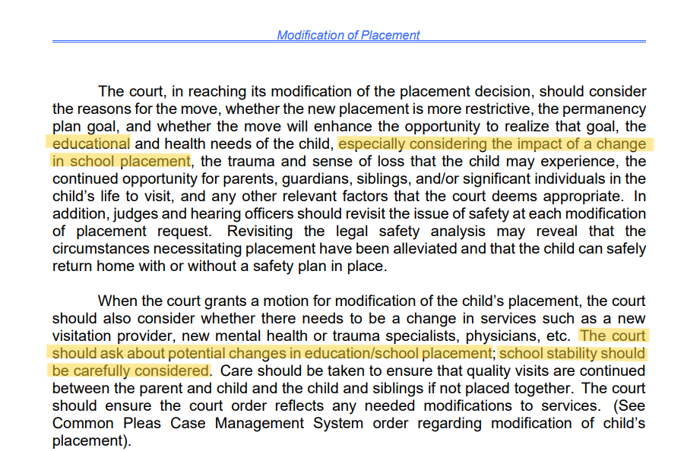

Education to be considered at all stages

Slide 60
School Stability
Pa. Court Rule 148 (amended 2019): requires Judges to address both “school stability and access to public schools”
Rule 148 emphasizes and presumes that a student SHOULD attend the local public school, rather than an “on-grounds school” unless:
It is not in the best interest of the student
“Security and safety of student”
Treatment needs
The Court finds it is not “protective of the community, "after considering evidence”
All children in residential facilities have a clear legal entitlement to attend the local public school where the residential placement is located unless there is a court order specifying a school placement. 24 P.S. § 13-1306

Slide 61
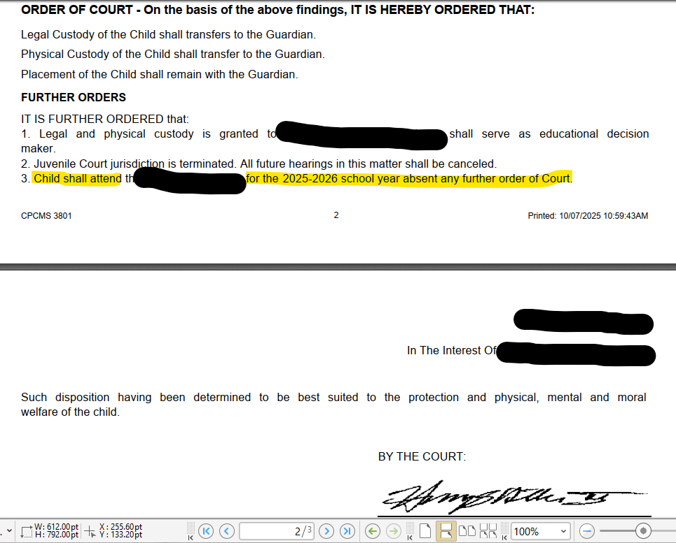
Court orders can clarify and maintain school stability

Slide 62

Ensure “Access” to public schools
Over
62%
of child welfare professionals reported that their clients were
“refused”
enrollment by public schools
78.6%
reported that children in residential placements
“sometimes”
Or
“rarely”
accessed local public schools
Unsafe and Uneducated report (Dec. 2018)
Notes:
Encourage offices to collect their own data and survey their youth. Add the question to your regular intake processes.
Seventy-one percent of youth in residential placements surveyed for the 2011 report stated that they attended on-site schools.181 Fifty-six percent of providers reported that “none” or “less than 10 percent” attended public school.182 Over 62% of child welfare professionals reported that their clients were “refused” enrollment by public schools.183 At the time of the survey, there were over 6,200 children in residential placements across Pennsylvania.184 According to a 2013 Report to the Pennsylvania State Roundtable issued by the Educational Success and Truancy Prevention Taskforce, of the 42 county teams that responded to a statewide survey, 78.6% reported that children in residential placements “sometimes” or “rarely” accessed local public schools. Only 2.4% of respondents indicated that children attending on-grounds schools “always” received educational services and opportunities equal to that provided in the local public school

Slide 63
Educational rights of children in residential placements
A court order specifies a different school placement, or
Federal and State law - A child placed in a residential facility should attend the local public school unless:
The child is currently expelled for a weapons offense.
The child’s IEP team determines that the student should be placed in an approved private school or other school placement, or
Joint state guidance from PDE and PA-DHS: Prohibits “bundling” unless it is a court imposed condition of placement.
Notes:
**** move behind 1306 slide

Slide 64
Ensuring there is *any* school is just the first half of the battle
Multi-grade classrooms
Uncertified or improperly certified teachers
Below-grade-level course work
Limited instruction hours
Relies heavily on worksheets or online credit programs
Minimal live instructions
Fails to advance basic skills
Notes:
Alternative settings, on grounds schools, recovery programs,

Slide 65
Ensuring educational quality
Consider Asking Students About the Following:
Is there a teacher or live instruction? Do you go to school in a classroom? What are the ages of the other students?
For how many hours a day are you in school? Daily?
What does school look like – laptops or tablets only; textbooks and notebooks; live instruction delivered online; worksheets to your room?
Is there a special service or support that you used to receive in the district school, but don’t get anymore at the residential on-grounds school?
Are you being restrained in the residential or school setting?
Do you have a graduation plan? Do you know if you are on track to meet it?
If you are only receiving worksheets for school, do you ever get any feedback?
How do you know how you are doing in school?
For Parents/EDMs of students with disabilities in care –
Did the LEA share the option for the student to be educated in the local public SD?
What % of teaching staff is qualified to work with students with disabilities?
How do you know how your child is doing in school? How long does it take to gain access to records?
When was the last IEP meeting? Do you have a copy?
Are there still learning, speech, or emotional etc., concerns? Have you been able to discuss these concerns with the school?
Does your student have a graduation plan? Do you know if they are on track to meet it?
Is there a related service or support that you used to receive in the district school, but don’t get anymore at the residential on-grounds school?
Notes:
Encourage emails
Memorializing conversations
Rely on court orders to show cause

Slide 66
Connecting the dots: legal systems, child welfare, education, and health

Slide 67
FACING BARRIERS WHEN TRANSITIONING FROM DETENTION CENTERS
Agnes
Dec. 2020: ELC was contacted by public defenders with reports that no education was happening for their clients who also were students with disabilities at X Facility.*
“Agnes”, a 17y/o Black female student, was a dually involved youth, with an IEP and other mental health needs. Agnes was about to be released from detention in December 2020.
An outdated IEP on file indicates Agnes was last reading at a 5th grade level.
Agnes was hoping to graduate that year (2021) from high school. Agnes reported sporadic access to schools and irregular schedules or academic feedback.
Upon the transition out of detention, Agnes became an unaccompanied homeless youth and separated from her parent (decision maker). She was between shelters and couch-surfing.
I worked to ensure Agnes maintained access to education and despite my involvement, we have faced several educational and delinquency related barriers:
Notes:
Pause to explain couch surfing and eligibility
Sch dist NOW HAS SURROGATE, COUNTY HAS A BULK OF TRAINED SURROATES
Agnes reports sporadic and limited schooling (30-45 mins./day)
No grades or feedback
Packets given to all student were the same
Unsure if she earned any credits
Special education was “not a thing” and never had an IEP meeting or any services.
The age of majority in education is 21, which means students must have an adult to help them make education decisions even if they are 18+ years old

Slide 68
FACING BARRIERS WHEN TRANSITIONING FROM DETENTION CENTERS
Access to quality general and special education services while incarcerated
Immediate School Enrollment despite entitlement under state law, ESSA, and McKinney Vento
Documentation as a barrier
Pendency placement and pushback on placements
District Appointment of a surrogate parent to assist with decision-making
New NOREP
Cycling-back to Detention settings
Status of expectant parent while in placement
Specific concerns expressed about restraints, safety, and access to adequate care
Academic and transitional IEP goals revised; joint Zoom meetings for future planning (ELC, Defender, surrogate, social worker)
Release from Placement and New/Resurfaced Enrollment Barriers
Successfully enrolled into a public HS school in Delaware county that maintained her enrollment despite multiple moves.
Another move, some resistance, and some progress
IEP Goals Diploma; Counseling; New Baby
Graduation!!!
Notes:
ADD AMINATION & NOW HAS SURROGATE, COUNTY HAS A BULK OF TRAINED SURROATES
WAS NOT RECEIVING PROPER EDUCATION WHILE IN DETENTION, WAS RELEASED ND WAS ENTITLED TO IMMEDIATE ENROLLMENT, WHICH SHE HAS NOT RECEIVED, WHICH MEANS WE WILL BE SEEKING COMPENSATORY SERVICES.
Agnes reports sporadic and limited schooling (30-45 mins./day)
No grades or feedback
Packets given to all student were the same
Unsure if she earned any credits
Special education was “not a thing” and never had an IEP meeting or any services.
The age of majority in education is 21, which means students must have an adult to help them make education decisions even if they are 18+ years old

Slide 69

Ways to support
Ask questions = ensure progress
Ensuring IDEA procedural timelines are followed
Last IEP meeting?
Last re-eval?
ESY?
Quarterly data?
Requesting a Point of Contact through Act 1
Ensure steps are followed, records are transferred, credits accurately counted, and that there is a graduation plan
Requesting/Encouraging Meetings
With teachers, special education directors
On-site visits or more creative options
Records review
Report cards
transcripts
Notes:
Key takeaways

Slide 70

Questions or reactions?
Notes:
Questions submitted by counsel:
1. Enrollment deadline for receiving district after change in placement, delays citing lack of records.
2. GED programs and disenrollment since the extension of mandatory school age to 18.
3. What criteria exists to determine best interest between cyber and in person schooling?
4. BID process and limits of court order to supersede. BID process as it relates to our youth who move, sometimes frequently, from placement to placement: Who schedules a BID meeting, timeframe for the meeting? Who is or should be invited to attend, etc.? An overview of the requirements.
5. Guardian ad litem as EDM, any ethical considerations or conflict

Slide 71

ELC resources & Contact Information
Back to School Guide for 2025-26 SY
Affirming & Safe Schools
Act 1: Accessing Supports
Enrollment
School Discipline
Attendance & Truancy
Bullying & Harassment
Honest & Inclusive Schools
Students with Disabilities
Early Childhood Education
KYR: Students in Care
Juvenile Justice Involvement
Students Experiencing Homelessness
English Learners & Immigrant Students
School Funding
LGBTQ & Gender Nonconforming Students
Education Law Center-PA
Intake: 215-238-6970
Email: info@elc-pa.org
Online Intake Form
Notes:
https://www.elc-pa.org/2024-back-to-school-guide-for-students-families-advocates/
Helpline calls are streamlined

Slide 72


Education law center-pa
Ashli Giles-Perkins, m.ED, ESQ. Staff Attorney
agiles-perkins@elc-pa.org
(215) 346-6905
PHILADELPHIA 1800 JFK BLVD.
Suite 1900A
Philadelphia, PA 19103 215-238-6970
Pittsburgh 429 Fourth Avenue, Suite 702
Pittsburgh, PA 15219
412-258-2120
www.elc-pa.org
Facebook.com/EducationLawCenter
@EdLawCenterPa
Notes:
Email or call me or call the helpline .. I can answer questions or give advice. If seeking longer term representation thru the project (emphasis on intakes first) and then representing

Slide 73
Reference Materials:
• 24 P.S. §13-1306 statute
• PDE guidance on Non-Resident Students in Institutions
• Act I of 2022 (BEC),
o ELC's Factsheet on Act 1
o 24 P.S. § 13-1331.1 statute
• Supporting Success for Pennsylvania’s Students in Foster Care: Data, Outcomes, and Stories from the Field (May 2025 Report)
• Education Decision Maker Toolkit & Guidebook (2018)
• PA Dependency Bench Book (4th Ed., Revised Feb. 2025)
• Unsafe and Uneducated: Indifference to Dangers in PA Residential Child Welfare Facilities, Dec. 2018 Report
Joint Non-regulatory Guidance: Ensuring Educational Stability for Children in Foster Care, U.S. Dept. of Education and Dept. of Health and Human Services (June 2016)

