Slide 1

Bloom For Women
Carol Andersen, CEO
Alyssa Almonti, Residence Manager
May 28th, 2025

Slide 2

MISSION AND VISION
Providing sanctuary and a continuum of care to heal, empower and employ survivors of sex trafficking & sexual exploitation.
A lifelong sisterhood of hope, healing and freedom.
We are fighting this battle today, so it’s not your daughter or loved one tomorrow.

Slide 3
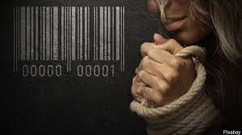

THE PROBLEM
Sex Trafficking
The recruitment, transportation, provision, or obtaining of a person for the purpose of a commercial sex act where such an act is induced by force, fraud, coercion, or in which the person induced to perform such act has not attained 18 years of age.*
*Source: The Federal Trafficking Victims Protection Act
www.bloomforwomen.org
Notes:
Human Trafficking is the second largest criminal industry in the world, and it is the fastest growing!
As a side note: 1st is Drug Trade and a close 3nd is Counterfeiting fake and pirated goods - fashion, drugs, food, electronics
Therefore, human trafficking is about the power of ownership over another human being, treating her as a commodity, for personal gain, whether that’s financial or material gain or sadistic pleasure. Ownership of another human being is slavery. Source: Nordic Model Now!

Slide 4
THE PROBLEM
National Human Trafficking Hotline*
432,902 signals received
100,891 case of human trafficking
197,000 victims identified in these cases
80% were sex trafficking
82% female
72% adults
Pennsylvania ranks 11th
New Jersey ranks 16th
in the country for the number of signals made to the Hotline
*data from 2023, the most recent year for which there is published data
www.bloomforwomen.org

Slide 5
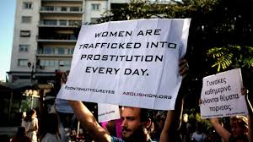
THE PROBLEM
Global System of Exploitation:
Sex trafficking, prostitution, pornography & stripping
Prostitution is not a choice, it is the absence of choice
A woman doesn’t choose prostitution, she chooses survival
Society & individuals take advantage of this lack of choice
90-94% of women who are
labeled “prostitutes” are
under third party control
(9 out of 10)
www.bloomforwomen.org

Slide 6
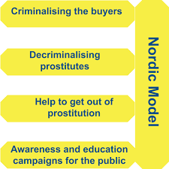
THE PROBLEM
Nordic Model
(also known as the Equality & Abolitionist Model)
offers real choices, empowerment & real freedom
full decriminalization for victims & holding buyers/traffickers accountable
Formally adopted in Sweden, Norway, Iceland, Northern Ireland, Canada, France, Ireland & Israel and Maine in the U.S.
www.bloomforwomen.org
Notes:
You can learn more about the Nordic Model at www.nordicmodelnow.org

Slide 7
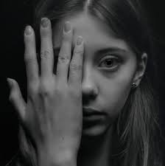
THE PROBLEM
The average age of entry into “prostitution” is 11-15 years young
Up to 84% of prostituted women and girls are survivors of childhood sexual abuse
*World Without Exploitation, January 2020.
www.bloomforwomen.org

Slide 8
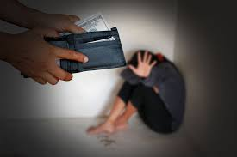
THE PROBLEM
20% of men have paid for sex
6% of men have done so in the past 12 months
25% of active buyers transact monthly or weekly
*Demand Abolition, November 2018
www.bloomforwomen.org

Slide 9

THE PROBLEM
The internet (and the pandemic) has changed how prostitution is organized and online pimping can include video, still photos and social media accounts
From 2019 to 2021, online recruitment increased 22%; Facebook & Instagram recruitment increased 120%
*Polaris, National Human Trafficking Hotline
www.bloomforwomen.org

Slide 10

THE PROBLEM
Victims are generally recruited
by someone they know.
Recruitment by family members & intimate partners increased 47% from 2019 to 2020
*Polaris & National Human Trafficking Hotline
www.bloomforwomen.org

Slide 11
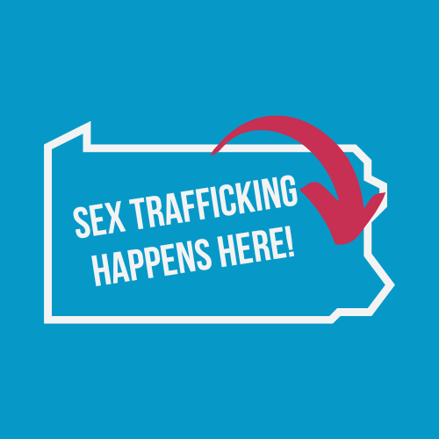
THE PROBLEM
Trafficking is happening in every community
Lehigh Valley is a “hotspot” for trafficking due to its proximity to major highways.
I-78 and I-80 travel directly from NYC through Harrisburg
I-95 corridor which runs from Canada to Miami, Fla.
One third of women in PA state prisons identify as victims of exploitation
www.bloomforwomen.org

Slide 12
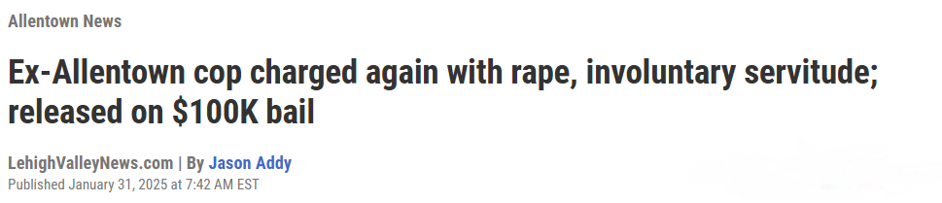
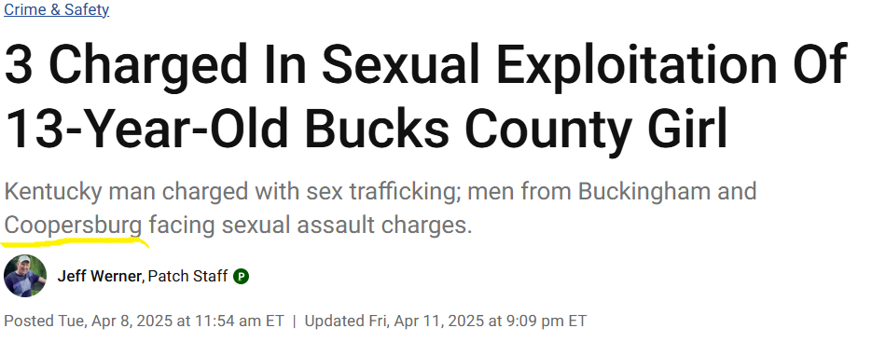
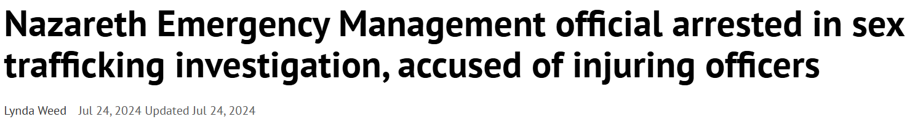
THE PROBLEM
www.bloomforwomen.org
Notes:
Former Allentown Police Officer Charged with Sex Trafficking – March 2025 – New charges of rape and sexual assault, these follow earlier charges of sex trafficking, soliciting prostitution, theft and harassment.
Coopersburg Man charged in Bucks County Sex Trafficking Case – April 2025 – A 42 year old man from Coopersburg was charged along with 2 others in the sex trafficking of a 13 year old girl in Bucks County. The child was lured in via social media to create a dating profile. The perpetrator located in Kentucky had never met the victim in person.
Nazareth Emergency Management official arrested in sex trafficking sting – July 2024 – Arrested during a joint federal and local sex trafficking operation. There were several arrested as part of this sting targeting those soliciting sex from a minor.

Slide 13
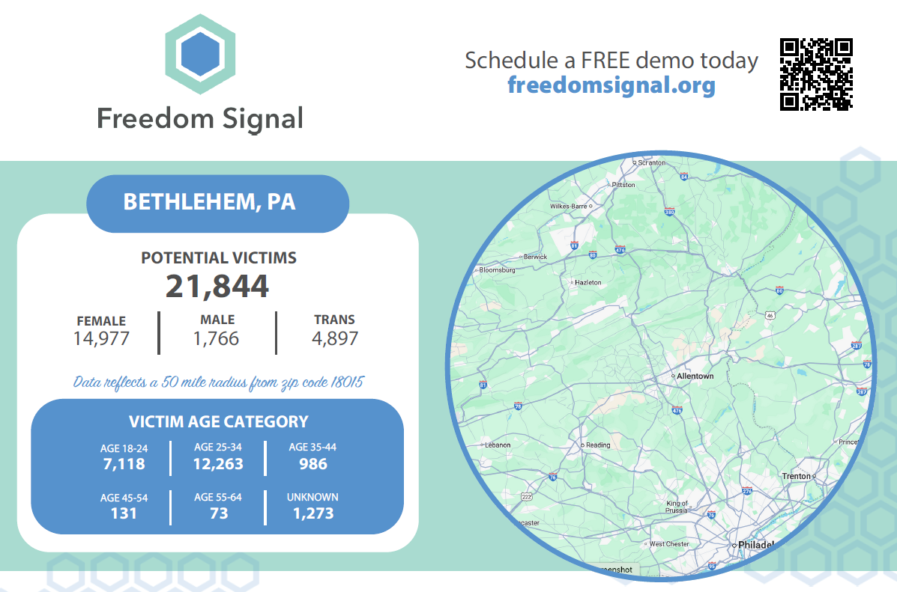
THE PROBLEM
www.bloomforwomen.org
Notes:
This graphic shows how many potential victims were identified through Freedom Signals’ technology within 50 miles of Bethlehem during a six month period.
Freedom Signal - Survivors of sex trafficking and software engineers came together to design a solution that allows advocates to directly reach those in the sex trade, offering help when someone posts an ad. No longer does a victim have to self-identify and search for help on their own; nor are victims dependent on getting a referral through the criminal justice system.
Freedom Signal is an online app for service providers and advocates that specialize in reaching victims of online sex trafficking or sexual exploitation. When a potential victim replies to a direct outreach message, it enables advocates to develop relationships and build trust with vulnerable populations in acute crisis.

Slide 14
SURVIVOR NEEDS
Complex needs
Multidisciplinary approach is needed to address severe trauma and medical needs
Immigration and other legal issues
Safety concerns
Shelter, other basic needs and financial hardship
Lack of vocational training & criminal histories lead to employment & housing-related challenges
We are fighting this battle today, so it’s not your daughter or loved one tomorrow.
www.bloomforwomen.org

Slide 15
SURVIVOR NEEDS
Survivors suffer psychological harms
Mind/body separation/disassociated ego states, shame, grief, fear, distrust, hatred of men, self-hatred, suicide, and suicidal thoughts.
Risks from trauma
Post Traumatic Stress Disorder (PTSD) – acute anxiety, depression, insomnia, physical hyper alertness, self-loathing, etc.
We are fighting this battle today, so it’s not your daughter or loved one tomorrow.
www.bloomforwomen.org

Slide 16





HOW WE ARE RESPONDING
Our Homes – Offering a Continuum of Care
Residential Housing
Emergency Response
In partnership with law enforcement,
we ensure survivor safety and explore next steps.
Bloom offers a two-year residential program;
services for pregnant women and new mothers (and their babies);
and independent living opportunities for program graduates
in our five homes located throughout the Lehigh Valley.
www.bloomforwomen.org
Notes:
Emergency Response: Bloom provides emergency safety for survivors of sex trafficking and sexual exploitation. Bloom’s outreach line is staffed by trauma-informed staff who can respond to a survivor in need of safety from violence and their traffickers. As part of Bloom’s emergency response, survivors are given a safe place to stay, emergency supplies such as food, clothing and essential personal hygiene items. Staff provides case management and referral services to support a survivor as she chooses her next step.
Bloom operates 5 homes in the Lehigh Valley.
Our two-year residential programs is for women survivors of sex trafficking, exploitation and addiction. It provides structure and support to heal, empower and employ women survivors through safe housing, trauma-informed programming, partnerships with treatment providers, vocational and educational training, and ongoing connections with a growing community of supporters that believe it’s never too late to start over. This program operates without 24-hour staff or live-in supervision and all services are offered to the women participants at no cost to them.
We also offer a two-year residential program for pregnant and parenting survivors providing a safe space for these survivors as they heal, deliver and care for their baby.
Furthermore, we offer fee-based independent living residences for program graduates as they transition to a life of independence.

Slide 17


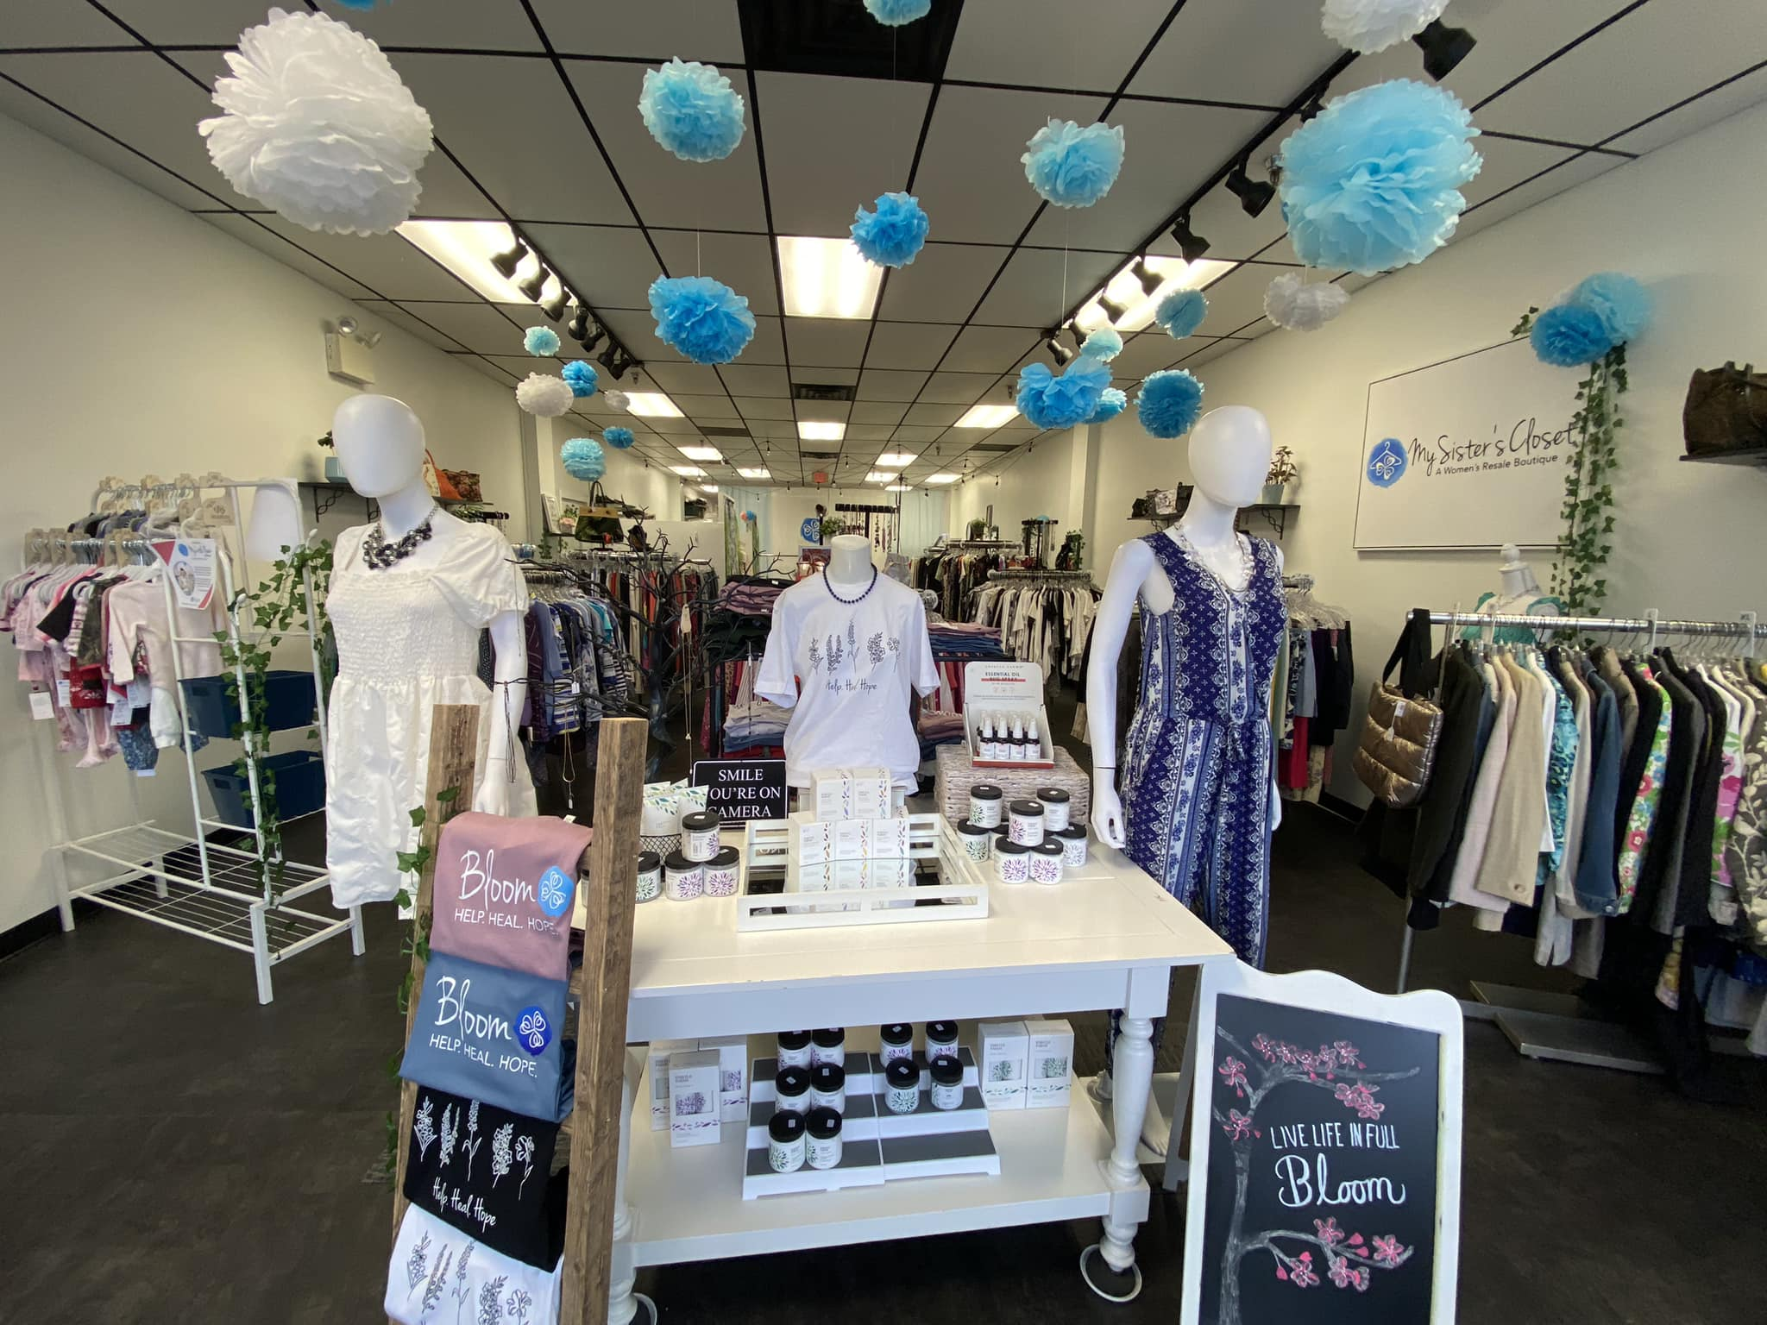
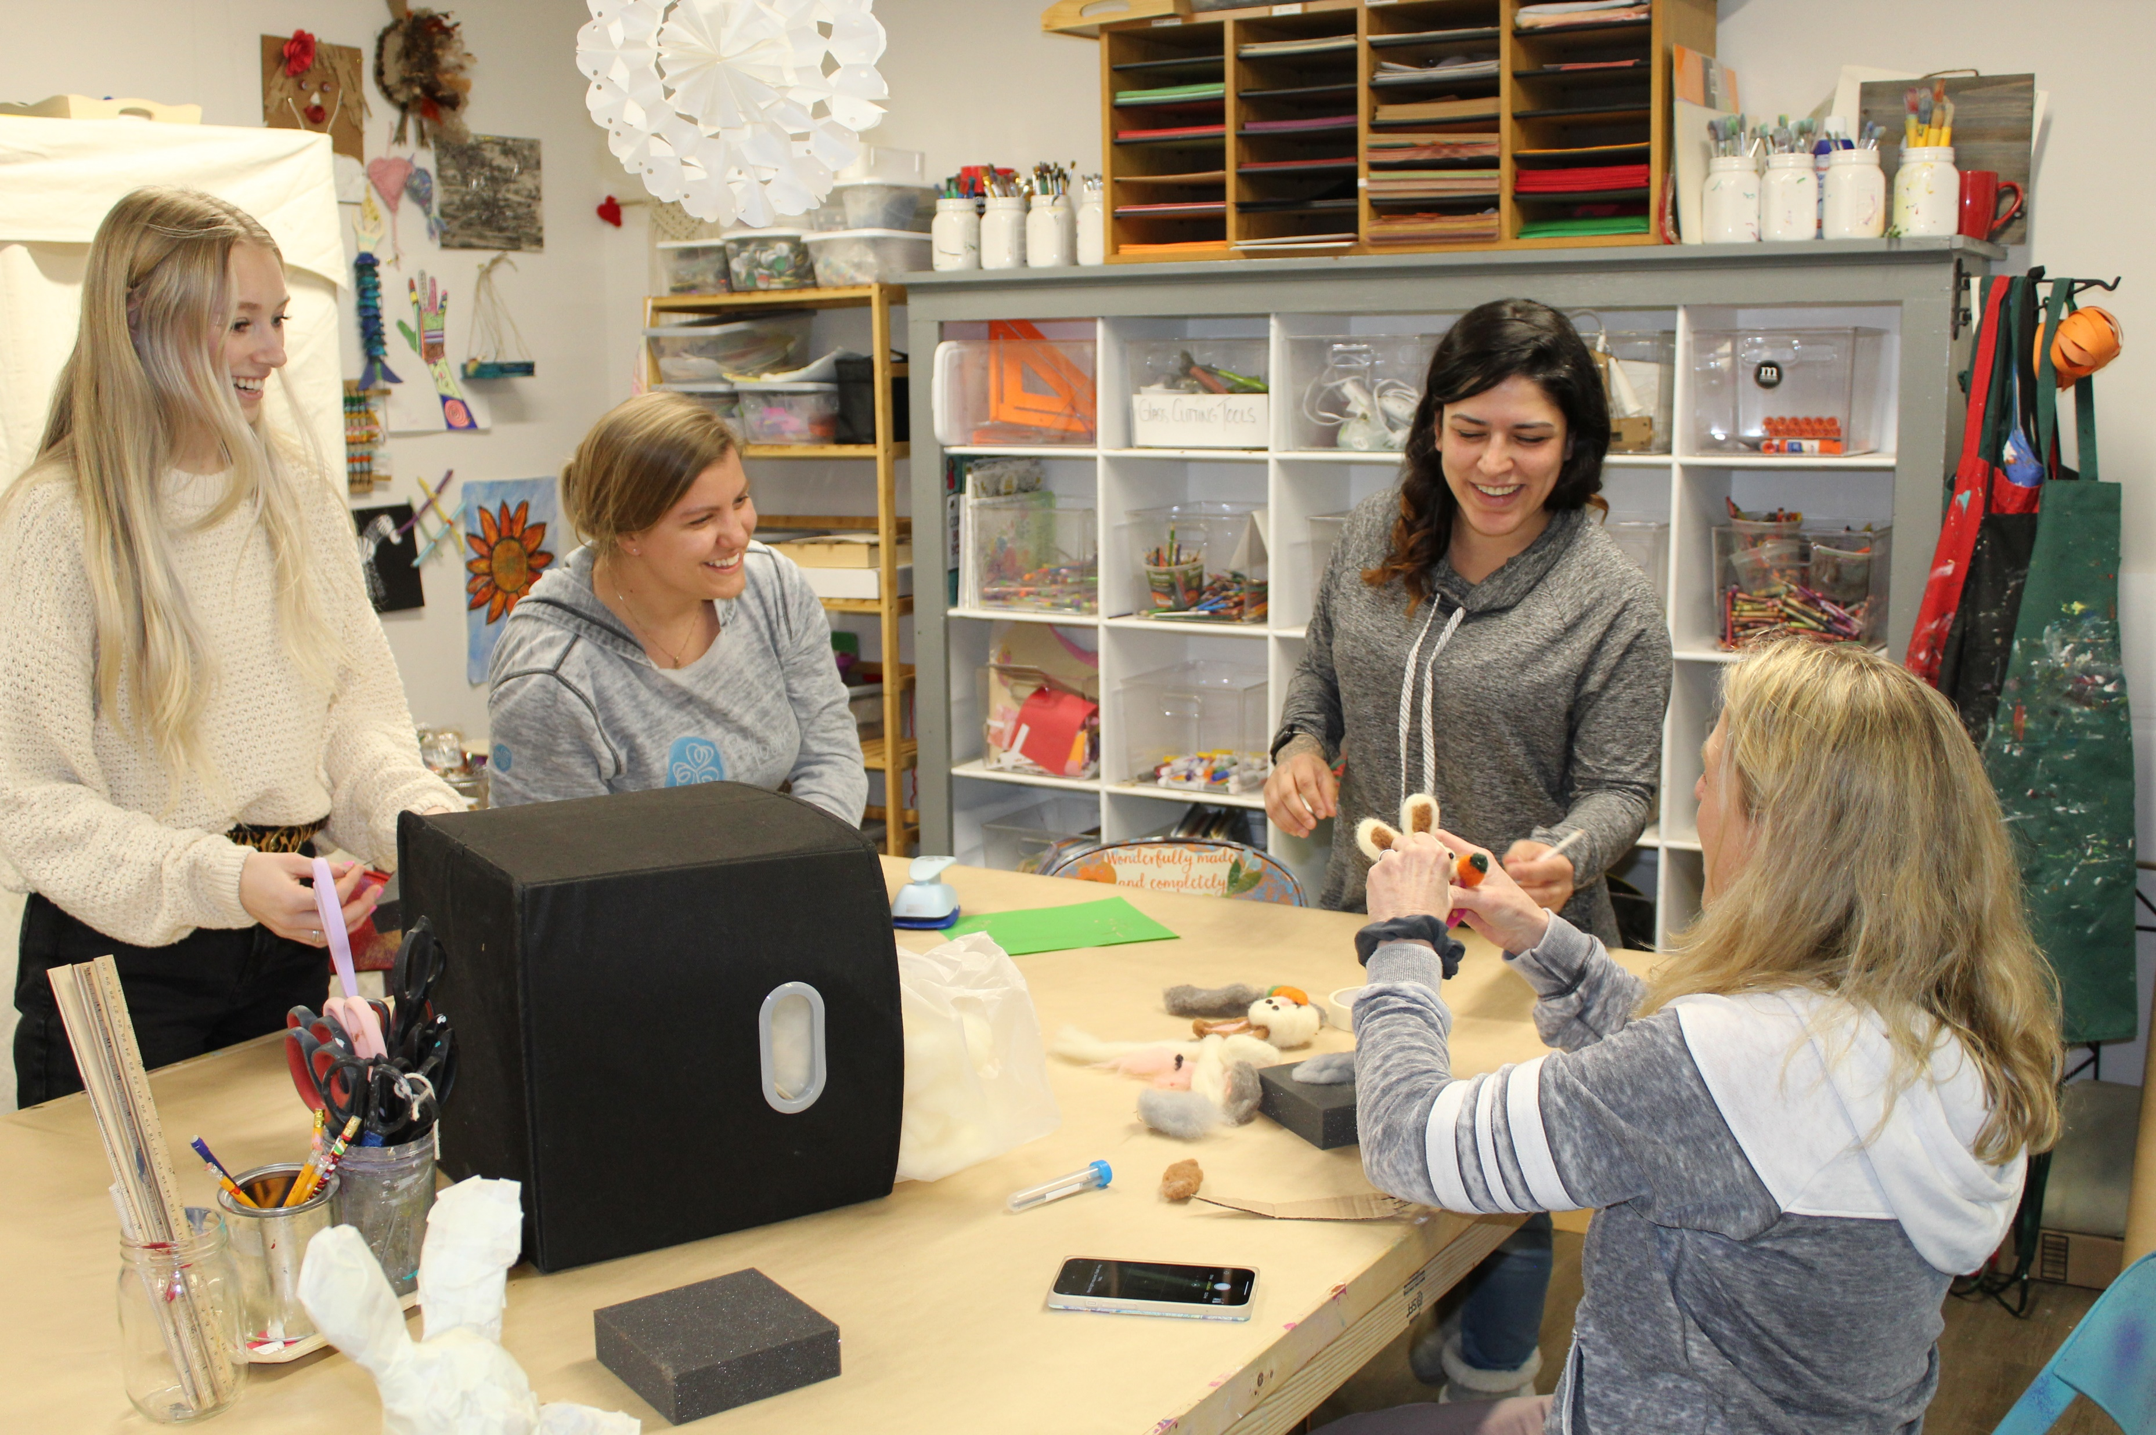

HOW WE ARE RESPONDING…
FLOURISH – Our Workforce Development Program
Flourish helps Bloom residents and graduates gain financial independence.
New Social Enterprise
Bloom’s women’s charity boutique in Bethlehem
Bloom’s social enterprise leveraging art as a healing
Considering expansion of our social enterprise concept
www.bloomforwomen.org
Notes:
Everyone deserves a chance to start over. Flourish is our Workforce Development Program for Bloom residents and graduates helping them gain financial independence. Flourish provides job opportunities for program participants in their first year of recovery and is offered through our two (soon to be three) social enterprises, as well as through partnering companies throughout the Lehigh Valley – providing supportive workplaces for women leaving lives of addiction and violence.
My Sister’s Closet is a women’s charity boutique in Bethlehem providing employment opportunities for program participants and is a significant funding source for Bloom.
Bloom Creative Studio is social enterprise leveraging art as a healing tool and providing employment opportunities to program participants. The Studio offers classes, as well as hosts parties and events. It also has a gift shop, DIY crafts, pottery and glass fusion.
New Social Enterprise - We are currently researching opening a third social enterprise. This business will be a café based in Allentown that will provide more job opportunities for our program residents.

Slide 18

COMMUNITY OUTREACH
Outreach Initiatives:
Directly reaching survivors of sex trafficking and exploitation in the Lehigh Valley, extending our reach to women, men and children
Supporting Homeland Security, FBI and local law enforcement on sting operations and investigations
Coordinating community and prevention education activities

Slide 19


COMMUNITY OUTREACH
Bloom on the Inside
Our in-jail program offering assessments as well as individual and group psychoeducational programming in local jails and to provide safe housing for women leaving prison.
B.R.A.C.E.
Laundry Mat Ministries Partnership & Housing Authority
An eight-part, interactive community education program for youth and young adults ages 5-21. This weekly program in Allentown aims to develop relationships that will lead to victim disclosure, education and prevention.
www.bloomforwomen.org
Notes:
Bloom on the Inside
Our in-jail program offering assessments as well as individual and group psychoeducational programming in local jails and to provide safe housing for women leaving prison.
Street Outreach:
Laundry Mat Ministries Partnership & Housing Authority
Bloom staff attend this weekly program in Allentown to develop relationships that will lead to victim disclosure as well as the opportunity to educate those present to prevent future victimization.
Bloom offers a Kids Corner at the laundry to provide prevention services focusing on
Be Ready Aware Courageous, and Educated (B.R.A.C.E.).

Slide 20

THE BARRIER WALL PROJECT
Notes:
Barrier Wall Project

Slide 21
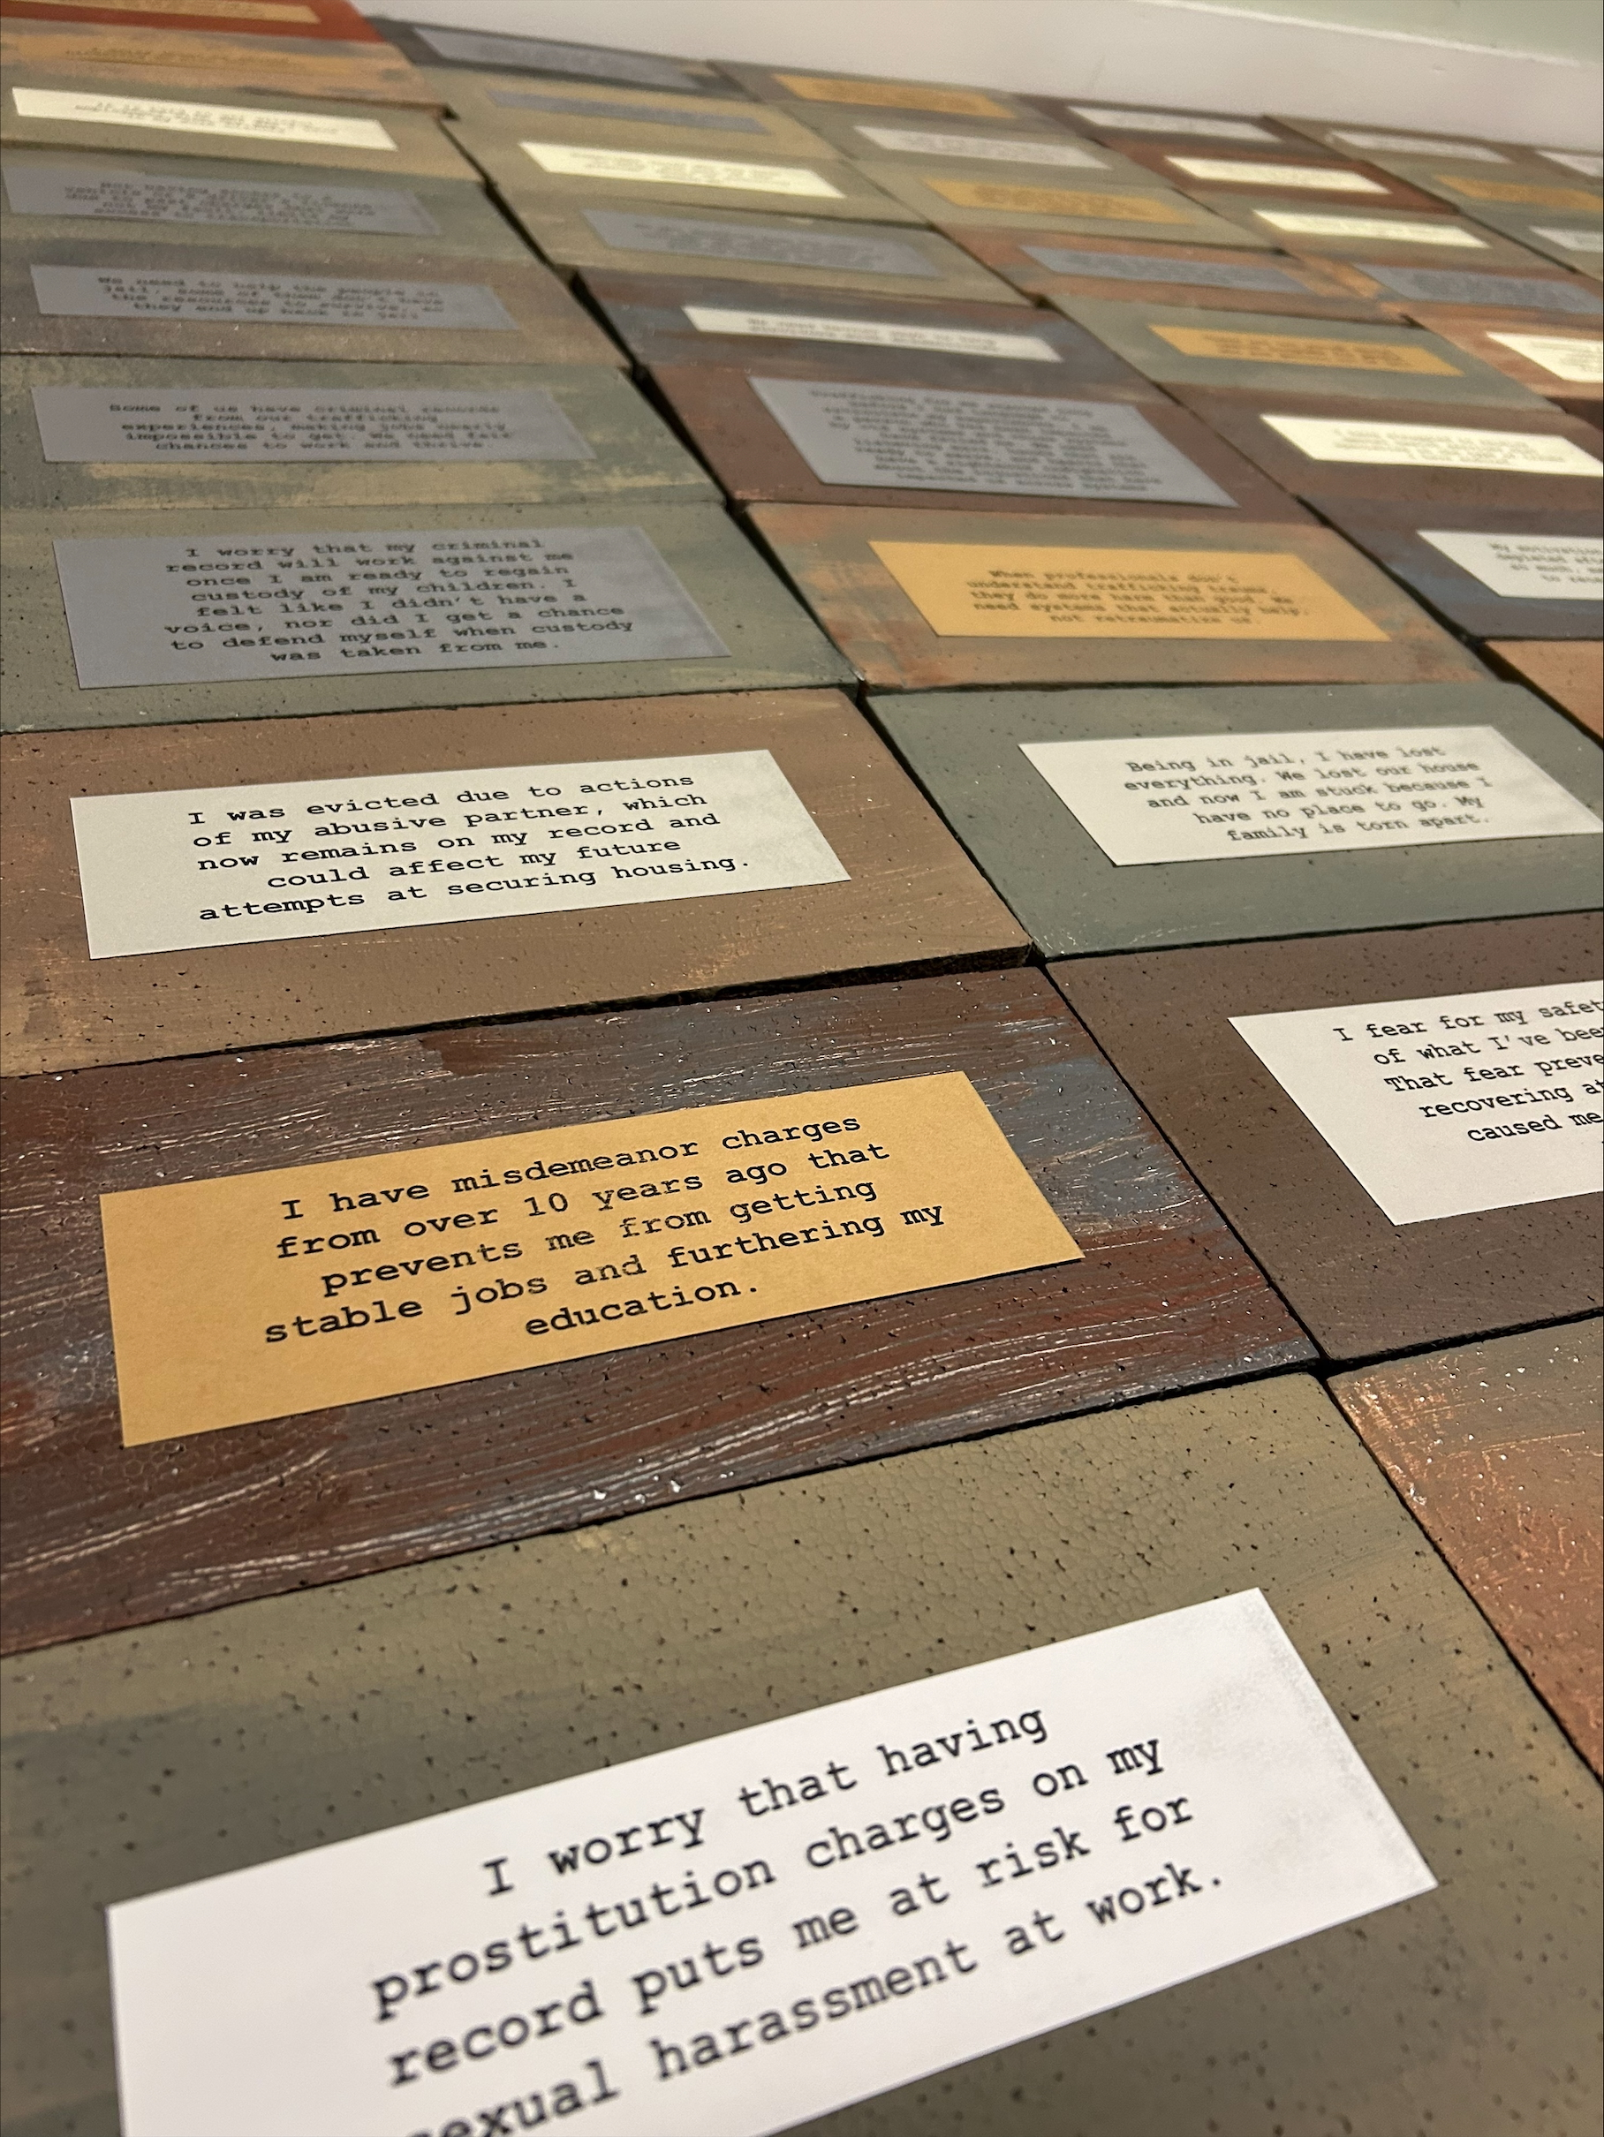
BARRIER WALL PROJECT
The Barrier Wall Project is a Lehigh Valley-based initiative that visually represents the real barriers survivors of trafficking and exploitation have encountered while rebuilding their lives. We asked survivors one powerful question:
“What barriers did you face when rebuilding your life?”
Their answers are displayed as symbolic “bricks” in a wall—each one reflecting systemic, societal, and personal obstacles such as housing, legal records, employment, and stigma.
This project aims to raise awareness, educate the community, and advocate for systemic change by amplifying survivor voices.
Notes:
Barrier Wall Project

Slide 22
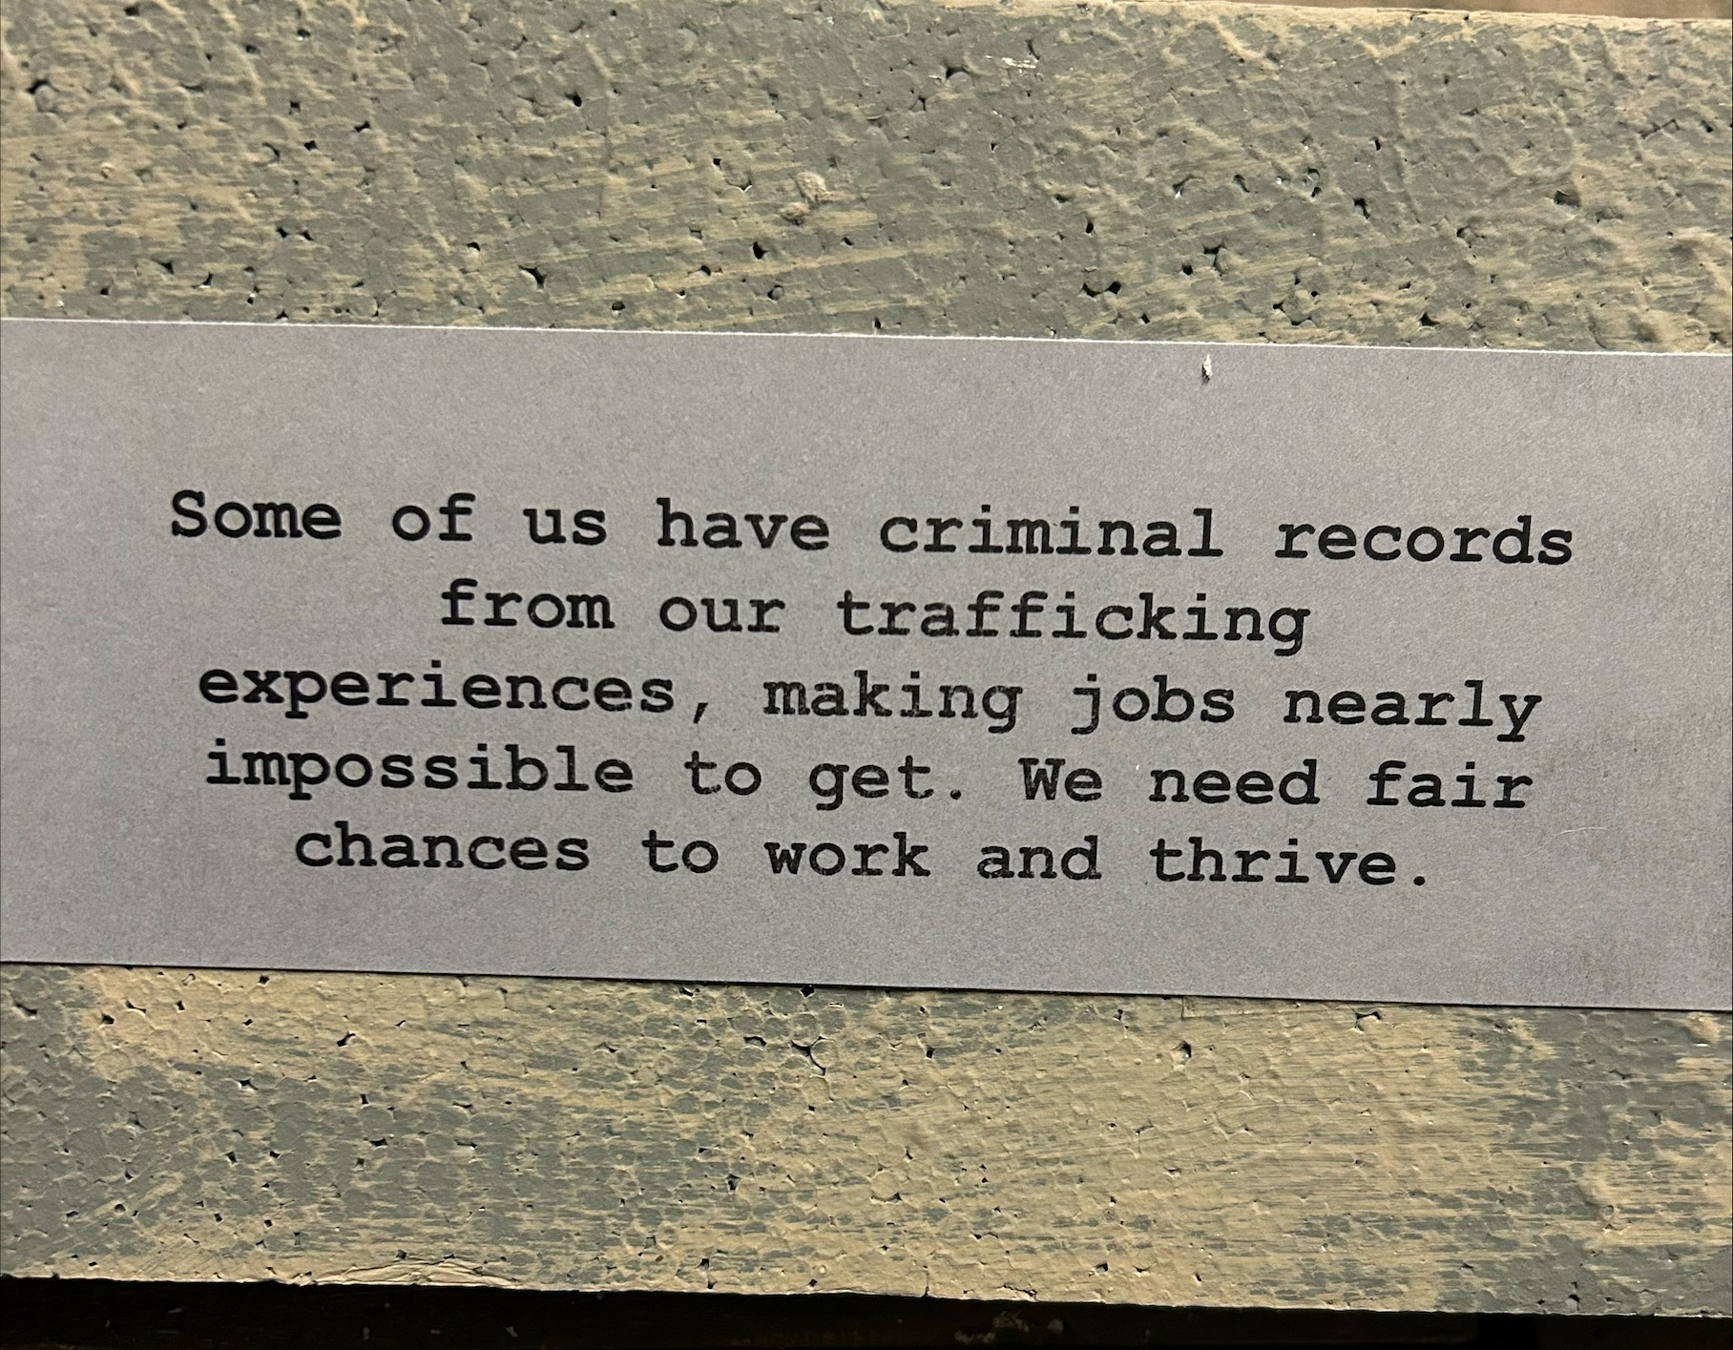
SURVIVOR NEEDS
“I have misdemeanor charges from 10 years ago that prevent me from getting stable jobs and furthering my education.”
“It is hard to get gainful employment with the gap I have in my work history. It is even harder to explain.”
“I worry that having prostitution charges on my record puts me at risk for sexual harassment at work”
www.bloomforwomen.org
Notes:
We asked survivors, what is your biggest barrier?

Slide 23
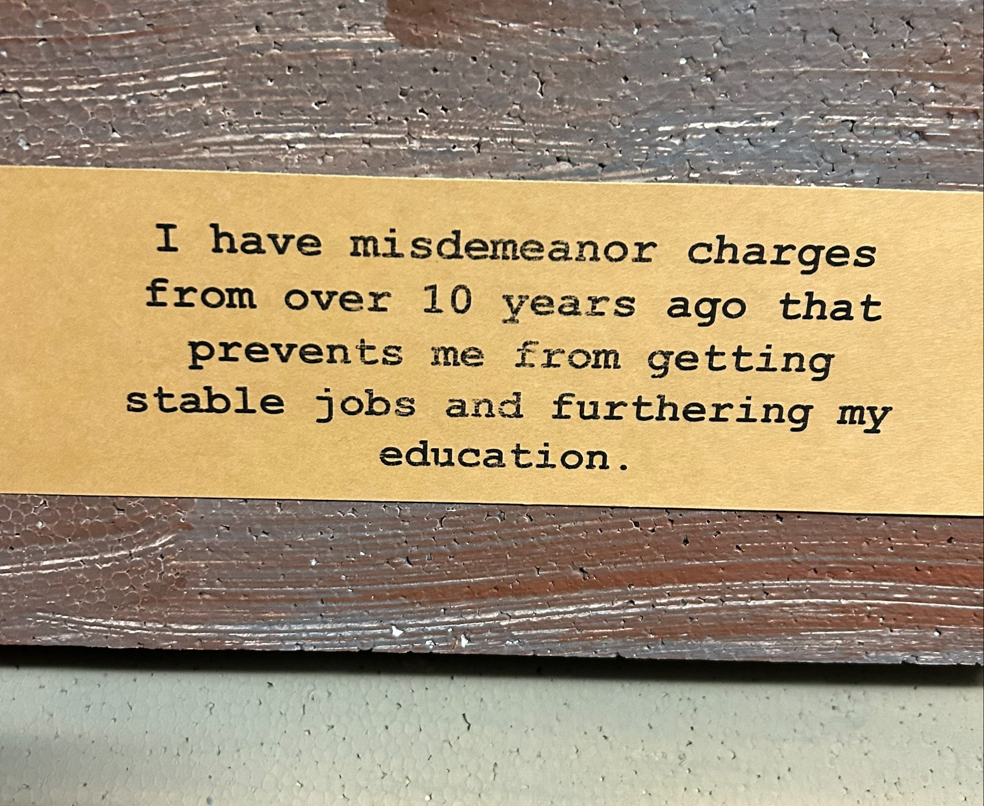
BARRIER WALL PROJECT
One of the most frequently cited barriers—reported by over 15% of respondents—was having a criminal record. This often includes charges that were directly tied to the exploitation they experienced. Yet, these records continue to limit housing, employment, and even access to supportive services.
Notes:
Barrier Wall Project

Slide 24
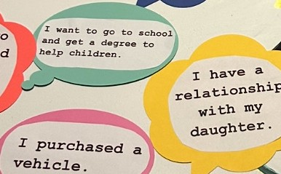
BARRIER WALL PROJECT
On the inside of the wall, we opened it up to our survivors once again, inviting them to share: What have you accomplished despite the barriers you’ve faced?“
"I got a college degree.“
"I had a safe calming birth and a place
that was free of drugs and abuse to
come home to.“
"I got custody of my kids.“
“ I got a job that looked past my criminal history”
Notes:
Barrier Wall Project

Slide 25
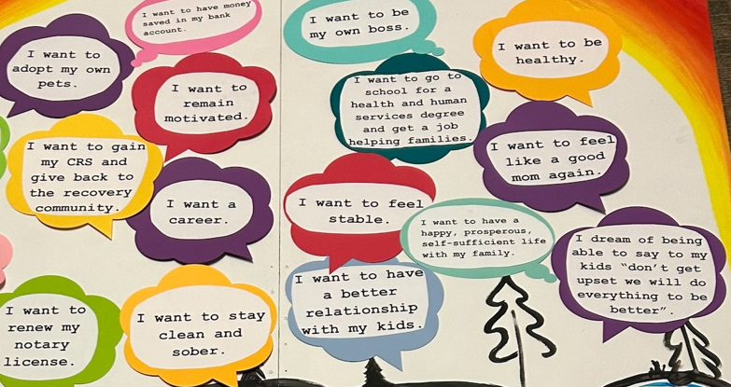
BARRIER WALL PROJECT
On the inside of the wall, we opened it up to our survivors once again, inviting them to share: What are your hopes and dreams?
Notes:
Barrier Wall Project
Hopes and Dreams:
My goal is to have an attorney see the seriousness of my case
I dream of having my family back together.
I want to give back.

Slide 26
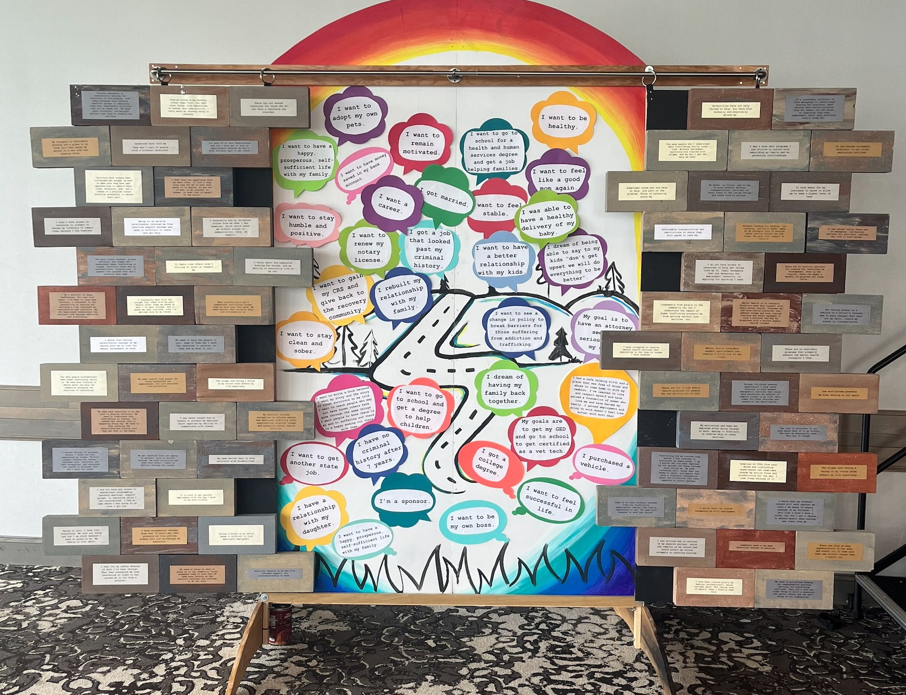
BARRIER WALL PROJECT
Notes:
Barrier Wall Project
Hopes and Dreams:
My goal is to have an attorney see the seriousness of my case
I dream of having my family back together.
I want to give back.

Slide 27

HOW CAN I BREAK BARRIERS?
As a member of a bar association, you can make a significant impact by:
Pro Bono Legal Work: Offer legal support to survivors of trafficking and exploitation in areas such as immigration, family law, or criminal defense.
Mentorship and Advocacy: Mentor survivors who are navigating legal processes, helping them understand their rights and advocating for policies that protect them.
Notes:
Barrier Wall Project
Hopes and Dreams:
My goal is to have an attorney see the seriousness of my case
I dream of having my family back together.
I want to give back.

Slide 28

HELP. HEAL. HOPE.
Thank YOU!
We appreciate your time and interest in our mission!

